Slide 1
Supporting the Mental Health of Volunteer Workforces - Ourselves
Notes:
Facilitator: Sharon

Slide 2
Notes:
Facilitator: Sharon

Slide 3
Program Learning Objectives
LEADERSHIP COMPETENCY DEVELOPMENT:
A character-based leadership development approach will build capacity for positive mental health, promoting self-leadership, peer leadership, and team-leadership. Training will include practical strategies to acknowledge, guide, and influence behaviour, and bring out the best in oneself and others.
MENTAL HEALTH MANAGEMENT TRAINING:
An integrated approach to workplace mental health will include knowledge and skills related to preventing volunteer-related harm to mental health, promoting positive mental wellbeing (including maximising the psychological benefits of volunteering), and appropriately addressing and supporting mental health problems as they arise.
Notes:
Facilitator: Sharon

Slide 4
Today’s Learning Objectives
By the end of today you will -
Experience how virtues inform leadership
Discuss how leadership looks in a volunteer context
Have a working understanding of mental health concepts and strategies to promote mental wellbeing
Have an opportunity to reflect on your experiences related to mental health and wellbeing in a volunteer context
Notes:
Facilitator: Sharon
Facilitator notes:
Confirm that participants have the virtue’s website and the jamboard page open

Slide 5
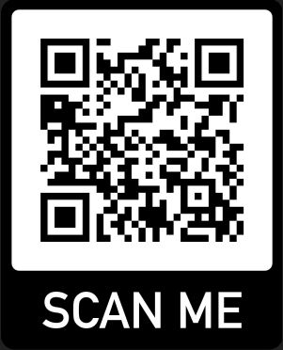
Ground Rules & Virtue’s Pick
In this session we will demonstrate –
Trust
Respect
Courage
Empathy
Duty of care
Learning program not therapy
Virtues pick – Scan the QR code on the left
Notes:
Facilitator: Sharon
Time – Slides 2, 3 & 4 – 15 minutes
Facilitator notes:
Facilitator asks participant to scan the QR code on the screen or to go to the virtues project website to do a virtues pick
Resources:
https://www.virtuesproject.com/

Slide 6
Virtues Pick and introductions
Scan your virtue
Read and reflect on your pick
Introduce yourself to the group, by stating:
- Your VIO and role,
- Your virtue and whether you feel it's an invitation or an affirmation.
Notes:
Time – 10 minutes
Facilitator (Toby) notes:
Facilitator introduces the virtues activity (see below notes)
Participants introduce themselves to the group using the points contained in this slide
Virtues – The participants get a few minutes to read the card to themself. Then participants share with their breakout group 1) what virtue they picked and what the card says, 2) explain if the card represents an invitation (i.e. is an invitation for them to call on/practice that virtue more in their life and work) or an affirmation (confirmation that this is a strength virtue of theirs, a virtue they are comfortable with and practice frequently).

Slide 7
What is leadership really?
Notes:
Time – Slides 7 – 14: 20 mins
Toby

Slide 8
What is leadership really?
Let’s start with what leadership isn’t
Notes:
Toby

Slide 9
What is leadership really?
Leadership isn’t position
You do not have to be ‘the boss’ to lead, and being ‘the boss’ does not mean you practice leadership…
Notes:
Toby

Slide 10
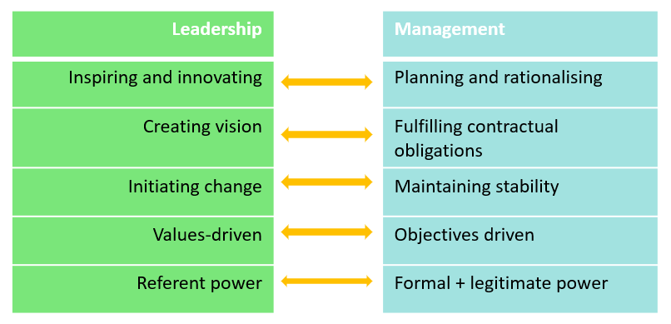
What is leadership really?
Leadership isn’t management
Notes:
Toby

Slide 11
What is leadership really?
Leadership isn’t one-size-fits all
Leadership does and should look very different in different contexts…leadership in a kinder class does and should look very different to leadership in state parliament or a tech start up
This means there is no single way to lead well, no one style that is best or right…no silver bullet
Notes:
Toby

Slide 12
What is leadership really?
We know what leadership isn’t – we also know what leadership involves…
Leadership involves:
Relationships – the ways we connect, built trust, rapport, respect, and forge meaningful relationships
Influence – affecting how others think, feel, act (this occurs through relationships)
Collective effort – when the total becomes more than the sum of its parts
Shared purpose – when we strive together towards a common goal
Notes:
Toby

Slide 13
What is leadership really?
The first step to practicing leadership is building relationships.
Building good relationships starts with being a good person…and being a good person is a matter of virtues.
Notes:
Time – 10 minutes
Toby

Slide 14
What is leadership really?
What are virtues?
Virtues are the building blocks of good character – they are the goodness part of us.
Virtues are also the basis of good relationships – virtues enable us to cultivate meaningful relationships.
We all have all the virtues in potential.
We each have a unique set of strength virtues – virtues that come easily to us, that we demonstrate regularly and consistently.
From the following list of virtues, write down 3-5 of your strength virtues
Notes:
Toby

Slide 15
fortitude, bravery, daring, valour, persistence, integrity, perseverance, zest, industriousness, vigour, authenticity, honesty, vitality, enthusiasm, energy, resilience,
love, kindness, care, generosity, nurturance, compassion, niceness, empathy, helpfulness,
citizenship, social-responsibility, loyalty, accountability, fairness, teamwork, leadership, autonomy, dignity, respect,
practical-wisdom, insight, decisiveness, understanding, detachment, judgement,
moderation, patience, forgiveness, mercy, humility, modesty, prudence, self-control, self-regulation, honesty,
appreciation-of-beauty, excellence, awe, hope, gratitude, optimism, future-mindedness, humour, playfulness, spirituality, purpose, faith, meaningfulness,
creativity, originality, ingenuity, curiosity, interest, novelty-seeking, openness, judgement, critical-thinking, love-of-learning, perspective
Notes:
Time – Slides 15, 16: 20 minutes
Facilitator (Toby) notes:
Once participants have noted their strength virtues, we can move on to Leadership in the Vol Context. I’ll return to strength virtues for the activity

Slide 16
Activity: virtues, leadership + mental health
In your breakout room, discuss:
- How do your strength virtues support your leadership practice?
How can leadership help – or hinder – mental health?
Come back to the group ready to share.
Notes:
Facilitator (Toby) notes:
Facilitator introduces the virtues activity
Facilitator assigns participants to breakout rooms
Participants come back to the main group and share their answers

Slide 17
Break
10 minutes

Slide 18
Mental health
Consider the below questions and add your initial thoughts to the jamboard
What is mental health?
What does good mental health look/feel like?
What does mental ill-health look/feel like?
What influences our mental health?
What is the relationship between volunteering and mental health?
Notes:
Time – 15 minutes
Facilitator (Ange) notes:
Facilitator asks participants to go to their jamboard*
Facilitator reads through some of the different contributions and opens the discussion to the group
*the facilitator will need to move the notes around the board as they will stack on top of each other

Slide 19
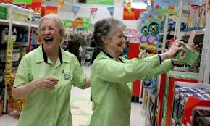
What is mental health?
A state of well-being in which you –
can realise your own potential
can cope with the normal stresses of life
can function effectively
can make a contribution to your community (e.g., family, friends etc.)
Notes:
Time – 20 minutes
Facilitator (Ange) notes:
Mental health is a positive concept related to the social and emotional wellbeing of individuals and communities.
Having good mental health, or being mentally healthy, is more than just the absence of illness, rather it’s a state of overall wellbeing.
The concept is influenced by culture, but it generally relates to:
- Enjoyment of life
- (More than just being happy) Having the ability to cope with and ‘bounce back’ from stress and sadness
- Being able to set and fulfil goals
- Having the capability to build and maintain relationships with others.

Slide 20
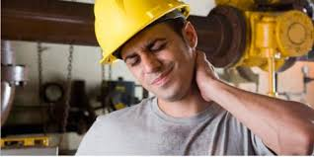
What is mental illness?
A mental illness is a health problem that significantly affects how a person feels, thinks, behaves, and interacts with other people.
A broad range of problems, with different symptoms e.g., depression, anxiety disorders and substance use disorders
Most of these illnesses can be successfully treated.
Notes:
Time – 20 minutes
Facilitator (Ange) notes:
Opposite to good mental health
A mental health problem also interferes with a person’s cognitive, emotional or social abilities, but may not meet the criteria for a diagnosed mental illness.
Mental health problems often occur as a result of life stressors and are usually less severe and of shorter duration than mental illnesses.
These often resolve with time or when the individual’s situation changes. However, if mental health problems persist or increase in severity, they may develop into a mental illness. Therefore, its important to get help early.
Mental illness is common, but it is still often misunderstood. Myths and misconceptions about mental illness add to stigma and make life harder for the people affected.
Myth: mental illness is a life sentence
Fact: Most people will recover fully, especially if they receive help early. Recovery will be different for everyone and some people may require ongoing treatment to manage their illness.
Some people have only one episode of mental illness and will completely recover. For others, symptoms associated with mental illness occur only occasionally with years of being well between episodes. For a minority of those with a more severe illness, periods of acute illness may occur more regularly and, without medication and effective management, leave little room for recovery.
Myth: mental illnesses are all the same
Fact: There are many types of mental illness. Simply knowing a person has a mental illness will not tell you how well or unwell they are, what symptoms they are experiencing, or what impacts the illness is having on their life.
Though a particular mental illness will tend to show a certain range of symptoms, not everyone will experience the same symptoms - for example many people with schizophrenia may hear voices, while others may not.
Mental illnesses are not purely 'psychological' and can have many physical features. While a mental illness may affect a person's thinking and emotions, it can also have strong physical effects such as insomnia, weight loss or gain, increase or loss of energy, chest pain and nausea.
Myth: people who live with mental illness are violent
Fact: Research indicates people receiving treatment for a mental illness are no more violent or dangerous than the general population. People living with a mental illness are more likely to be victims of violence, especially self-harm.
There appears to be a weak statistical association between mental illness and violence. This seems to be concentrated in certain subgroups, for example - people not receiving treatment, those who have a history of violence, and those who use drugs or alcohol.

Slide 21
Mental health disorders in Australia
1 in 5 adults have a diagnosable mental health condition
54% do not seek professional help
Reduced motivation, concentration, decision making capacity, impaired interpersonal functioning = poor work performance
Depression is the leading cause of disability
Notes:
Time – 20 minutes
Facilitator (Ange) notes:
Experiencing a mental health problem is common, if we don’t experience it ourselves, we will know someone that has, and it may well be someone close to us.
However only 46% of people will seek help, the other 54% won’t. This often comes down to a limited understanding of mental health, and an increased level of stigma surrounding mental illness.
As stigma continues to be a barrier for people when it comes to supporting their mental health (important as leaders to improve our own understanding of mental health, when to get help and address any misunderstanding or preconceived ideas we may have about mental illness).

Slide 22
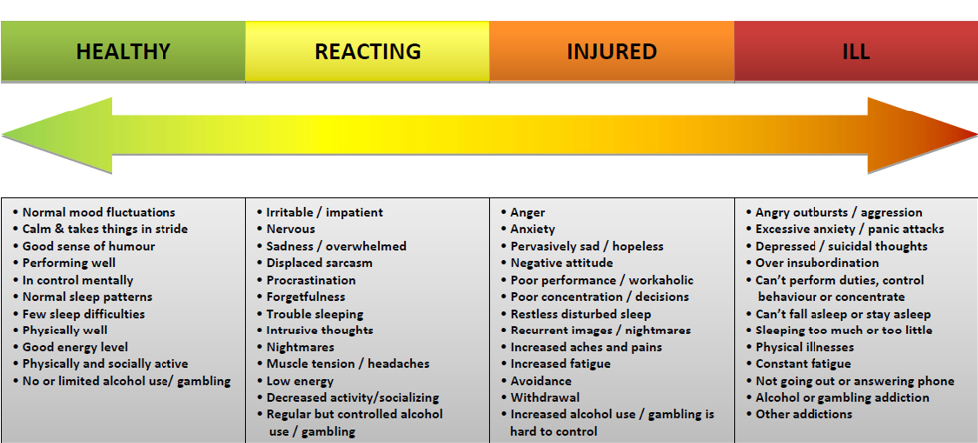
Mental health continuum model
Notes:
Time – 20 minutes
Facilitator (Ange) notes:
Present the mental health continuum
Link back to examples from previous group discussion
Mental health can be explored on a continuum
At one end, Flourishing represents optimal mental wellbeing
Next is Going OK. Experience good mental health and an absence of frequent or significant feelings of distress.
In the Struggling range is where mental health is impacted, feelings of distress and significantly impacting on daily life, including relationships. When you are shifting to the struggling end of the scale it is important to seek support. (Start with the Check-in website, or A Tasmanian Lifeline)

Slide 23
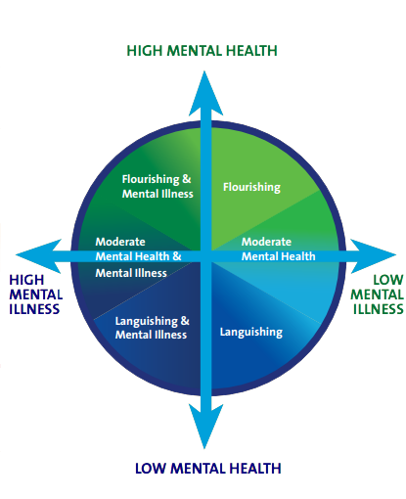
Other ways to look at mental health
Notes:
Time – 20 minutes
Facilitator (Ange) notes:
Present this model
Link back to examples from previous group discussion

Slide 24
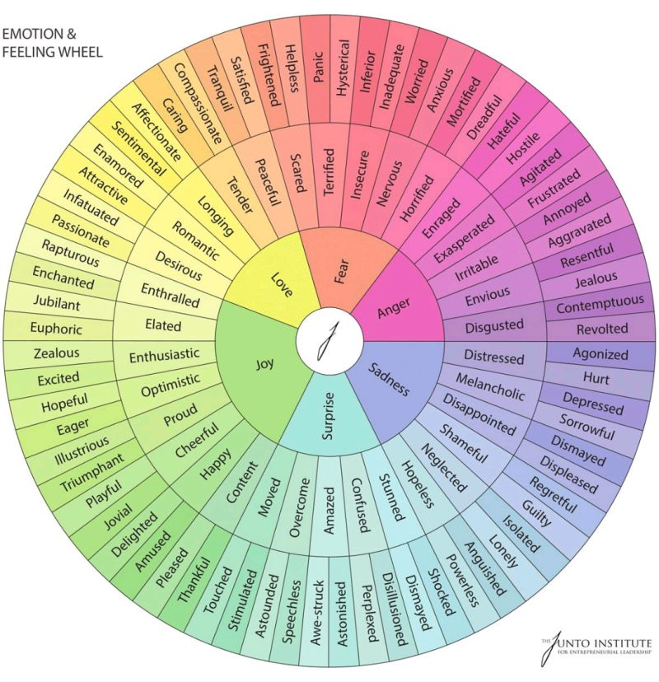
Other ways to look at mental health
Notes:
Time – 20 minutes
Facilitator (Ange) notes:
Present this model
Link back to examples from previous group discussion

Slide 25
Mental wellbeing strategies
Notes:
Time – 20 minutes
Facilitator (Ange) notes:
Discuss the five ways to wellbeing
De-mystify sources of help
Other options –
Checkin.org A Tasmanian Lifeline RAW

Slide 26
Activity – Mental health resources
Which of these resources resonate with you?
How could these resources support your mental health and wellbeing in your volunteer/volunteer coordinator role?
Notes:
Time – 20 minutes
Facilitator (Ange) notes:
Facilitator introduces the above activity
Facilitator assigns participants to breakout rooms
Participants come back to the main group and share what they discussed

Slide 27
Where to go for support checkin.org.au
Notes:
Bree to present 21-22
Checkin.org.au
Find information and resources so you can stay on top of your own mental wellbeing
You’ll be asked a few questions – to filter services based on your personal circumstances or the person you are concerned about
Find services to support in your local area
RAW and RFDS
Men’s Shed
A Tasmanian Lifeline

Slide 28
Where to go for support atasmanianlifeline.com.au | 1800 98 44 34
Notes:
A Tasmanian Lifeline
Tasmanian response during Covid – set up to support Tasmanians who have questions about their mental health and may need some extra support. You’ll be met by a trained worker who you can talk things through with, or if you just need someone to listen.
You don’t have to go through a difficult situation alone
A Tasmanian Lifeline offers non-judgmental, one-off or ongoing support for anyone having a tough time. So they can call you back if you want some extra follow up support.
8am-8pm every day of the year, or book a call back via the booking form on this website.

Slide 29
Innovation Program
we seek to help organisations adapt their operations after COVID-19, to effectively recruit, support and manage a more flexible workforce.
Innovation Projects:
Design Thinking program
Addressing a challenge within your group / organisation
Trialling new ways of working
Innovation Series:
Podcasts
Articles
Workshops
Notes:
Change is inevitable. Volunteering Tasmania has been funded to look at innovative ways to support organisations to think differently, be flexible and adapt to the changing environment around us. We are encouraging leaders within the volunteering sector to embrace the opportunities that COVID has created for us.
And as leaders we need to be able to hold that space where our volunteers are free to explore, adapt and innovate.

Slide 30
We know that volunteering provides positive benefits for people’s mental health and well-being.
During the COVID-19 lockdown in Tasmania (April to June 2020) the state’s volunteer numbers were hit hard with an estimated 140,000 volunteers lost to communities.
Some volunteers have not re-engaged.
Volunteer burn out is a common challenge and something we continue to address as a sector.
Supporting the Well-being of Volunteers

Slide 31
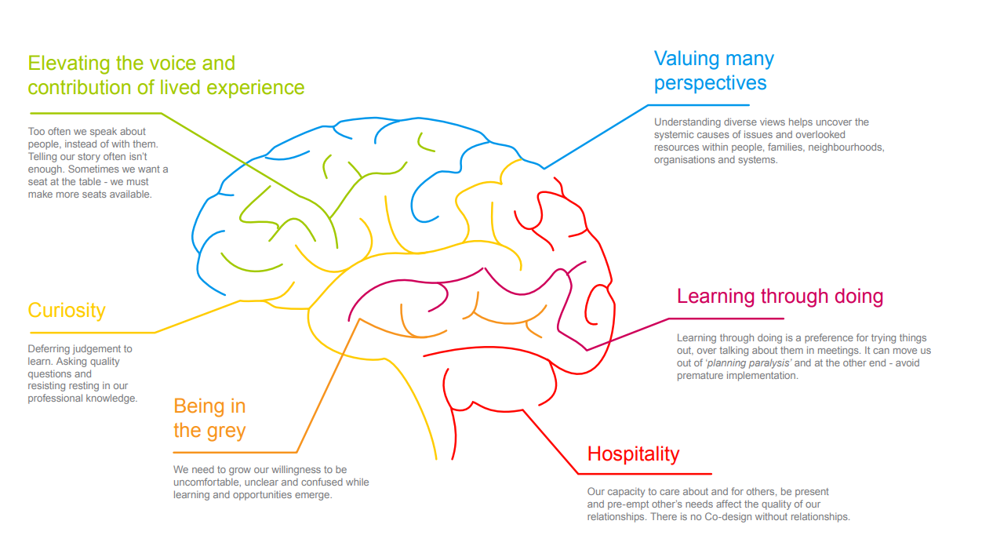
Notes:
Listening and ensuring volunteers feel safe to share their ideas. It means nothing if volunteers don’t feel genuinely heard.
Today you have been speaking about virtues. To truly lean into your virtues it’s important that as individuals we are able to move past our own understanding and hear from others.
Testing our own assumptions, getting curious about the experience of others and supporting an opportunity to be in the grey.

Slide 32
Reflection
What did / are you doing to support the well-being of your volunteers?
​
2. What have you seen others doing that interested you? ​
3. What are you going to start doing?

Slide 33
Explore:
Asking the volunteer if there are any supports they’d like.
The Art of Gathering – Priya Parker
Mastering Emotional Health – Global Leadership Foundation
Radicol Candor
Flexibility in programs – duration of shifts and frequency
Buddy Systems
Soft transition into volunteer roles
Opportunities to move
Learn and lunch / crafternoons​
Gardening club​
Moving – stretch class​
Meditation or mindfulness sessions
Have lunch breaks together and time to sit and chat

Slide 34
Activity: Self care plan​
Develop a self care plan using the handout provided (Blackdog Institute)
Provide template and talk through content provided in this handout
Notes:
Facilitator: Sharon
Time – 20 mins
Facilitator notes:
Ask participants to open the self care plan that was emailed to them
Facilitator introduces the activity
Participants individually work on their self-care plan
Resources:
Importance of self-care planning COVID-19 mental health and wellbeing resources

Slide 35
Wrap up & questions
Round the room: what was one thing that you will take away from this session to support your mental health and/or leadership?
Homework:
Finish and follow your self care plan
Resources
Rest of workshops – what’s next – program overview
Notes:
Facilitator: Sharon
Time – 10 mins

