Slide 1
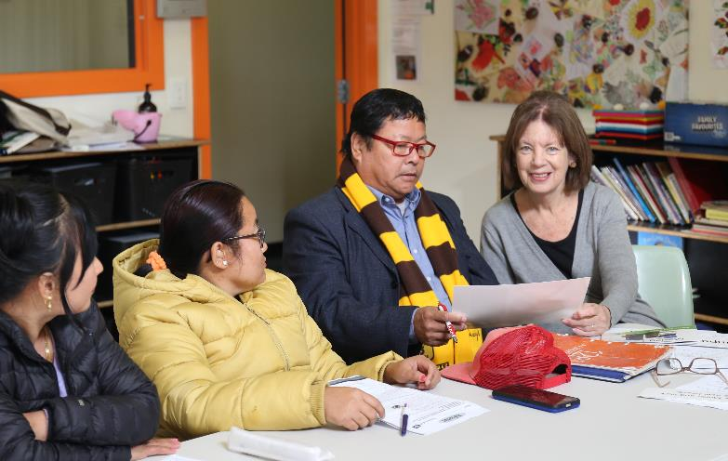
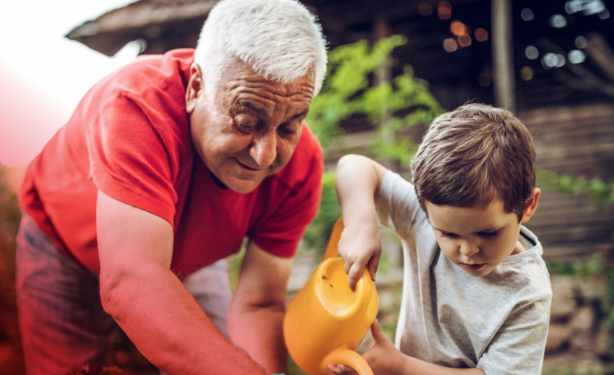
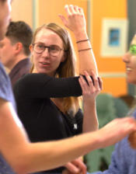
Introduction to Volunteering
March 2023
Notes:
Part One – What is Volunteering (General Volunteering Information)
Welcome and introductions (participants and presenters)
Include Acknowledgement of Country
Housekeeping if in person
Things to consider:
Who is in the audience? What are their language levels, backgrounds, diversity characteristics
Who is presenting the information? Perhaps invite someone from a migrant background to be involved in presenting too. This might be to provide general support, firsthand experience, or language translation.
Ensure you allow enough time for discussions as appropriate
Regularly check in with participants to ensure they are understanding
Invite questions

Slide 2
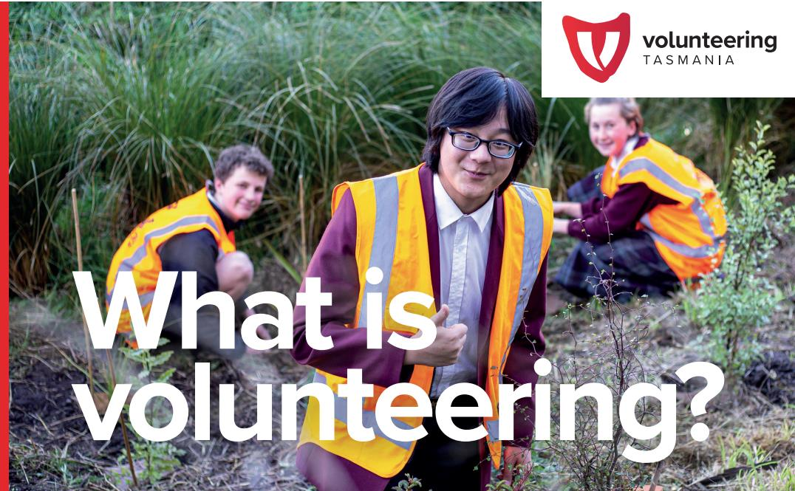
Time willingly given for the common good and without financial gain
Notes:
Part One – What is Volunteering (General Volunteering Information)
Official definition by Volunteering Australia: Time willingly given for the common good and without financial gain
Discussion prompts:
What do participants understand volunteering to mean?
Do they have experience of it in their home country or in Australia/Tasmania?

Slide 3
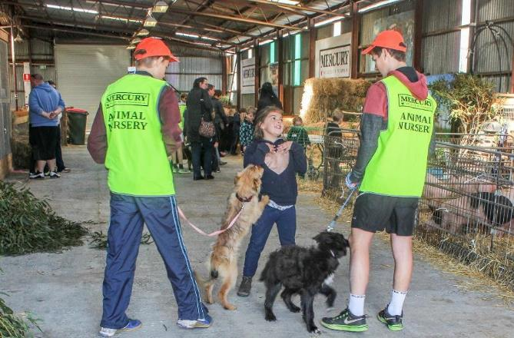
Volunteering is done by choice
Notes:
Part One – What is Volunteering (General Volunteering Information)
Volunteering is done by choice, you don’t have to volunteer
Discussion prompts:
What does it mean to willingly give your time, by choice?
Based on this definition, what sort of activities would not count as volunteering?

Slide 4
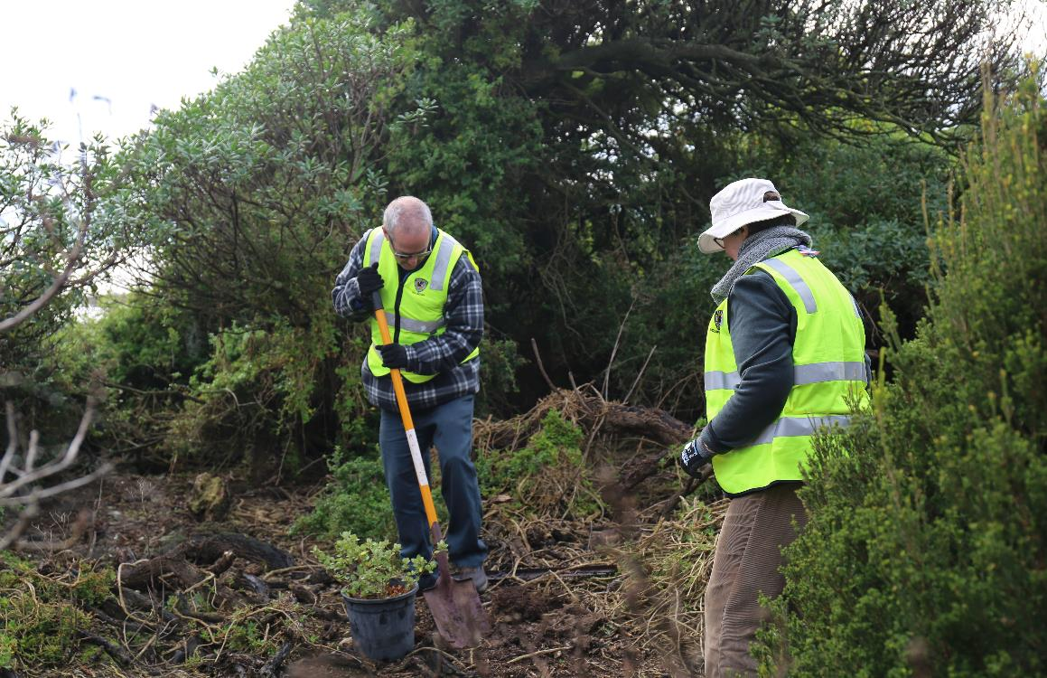
Volunteering can happen anywhere and anytime
Notes:
Part One – What is Volunteering (General Volunteering Information)
Volunteering can happen anywhere, and at anytime
Discussion prompts:
Volunteering can be online, in person or by phone
You can volunteer as frequently as suits you – think about how much time you wish to dedicate to volunteering and find something to suit.
It’s probably more common than you realise

Slide 5
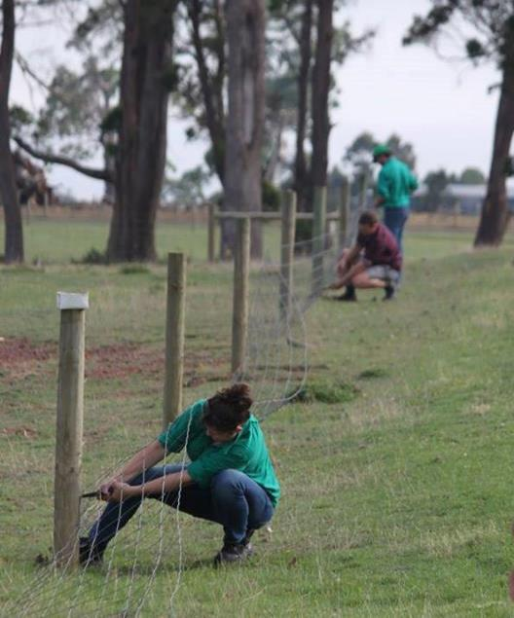
Volunteering benefits the volunteer and the community
Notes:
Part One – What is Volunteering (General Volunteering Information)
Volunteering benefits the volunteer and the community
Discussion prompts:
Informal volunteering also involves connecting or being active within or own cultural community
Participants may already be volunteering without realising it

Slide 6


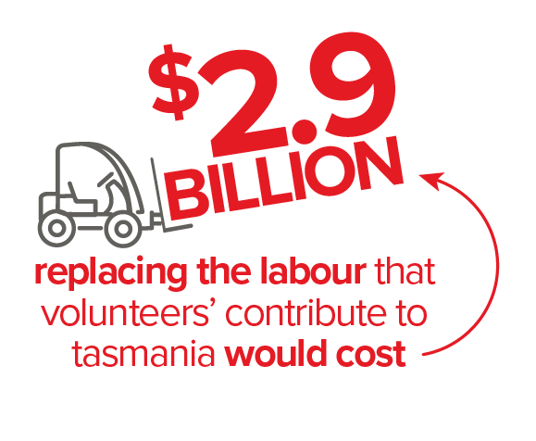
Volunteering in Tasmania
Notes:
Part One – What is Volunteering (General Volunteering Information)
Discussion prompts:
Volunteering is very common in Tasmania – our state has the highest proportion of volunteers!
Two thirds of the Tasmanian population volunteer each year, compared with approx. one half which the national average for volunteering.
The number of people volunteering in Tasmania makes it the largest sector
To replace these volunteers with paid workers would cost nearly $3 billion
There are enormous economic benefits to the State to support a thriving volunteer community

Slide 7
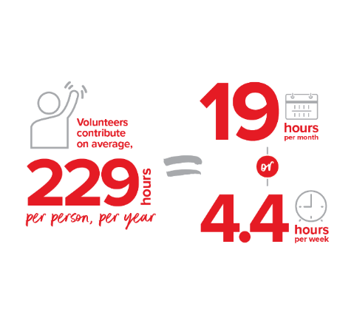
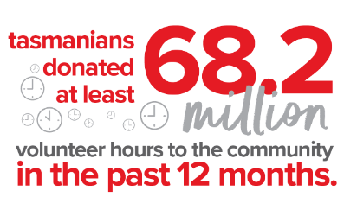
Volunteering in Tasmania
Notes:
Part One – What is Volunteering (General Volunteering Information)
Discussion prompts:
The average Tasmanian volunteer contributes 229 hours per year, which is 19 hours per month or 4.4 hours every week
In total, nearly 70 million volunteer hours are donated to the Tasmanian community each year

Slide 8

Why volunteer?
Notes:
Part Two – Why Volunteer (General Volunteering Information)
Discussion prompts
Why do you think people volunteer?
What kind of volunteering do you know about?
Have you done any volunteering, either in Australia or your home country?
If so, why have you chosen to do that volunteering?
Because volunteering is so common here, there are many different types of volunteering roles and also many different reasons why people choose to volunteer.

Slide 9

Fact.
Volunteers are happier, healthier and sleep better than those who don’t volunteer!
Notes:
Part Two – Why Volunteer (General Volunteering Information)
It has been scientifically proven that volunteers are happier, healthier and sleep better than those who don’t volunteer!

Slide 10
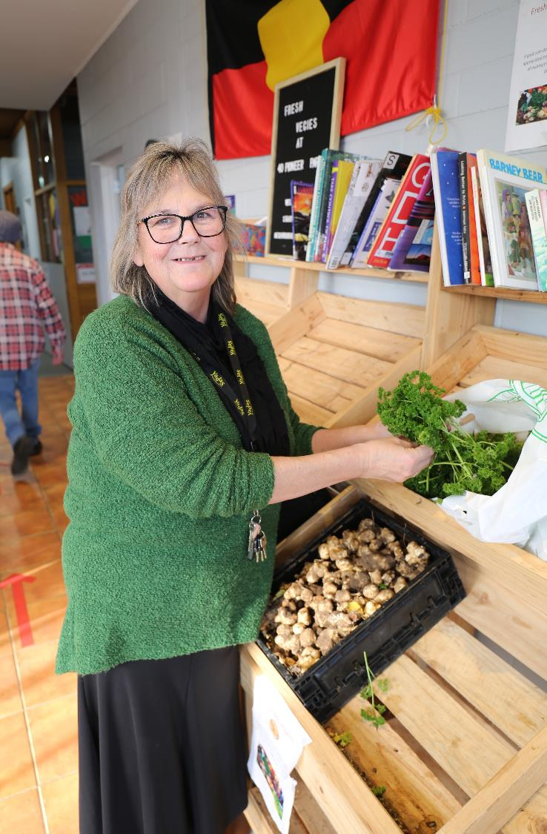
Volunteering is unpaid – but has plenty of other rewards!
Notes:
Part two – Why Volunteer (General Volunteering Information)
Volunteering is unpaid - but has plenty of other rewards
Discussion prompts:
Check in that people understand what this means

Slide 11
Benefits to volunteers
Professional experience
Improve job prospects
Learn new skills
Improve social skills
Connect to community
Make new friends
Healthy mind and body
Giving back
Purpose in life
Notes:
Part Two – Why Volunteer (General Volunteering Information)
Discussion prompts:
Benefits to self, include:
Improving social skills
Connecting to community
Making new friends
Healthy mind and body
Giving back to community
A sense of meaning or purpose in life
To gain professional experience
Improved job prospects (networks)
Learn new skills
Can participants think of other benefits?

Slide 12
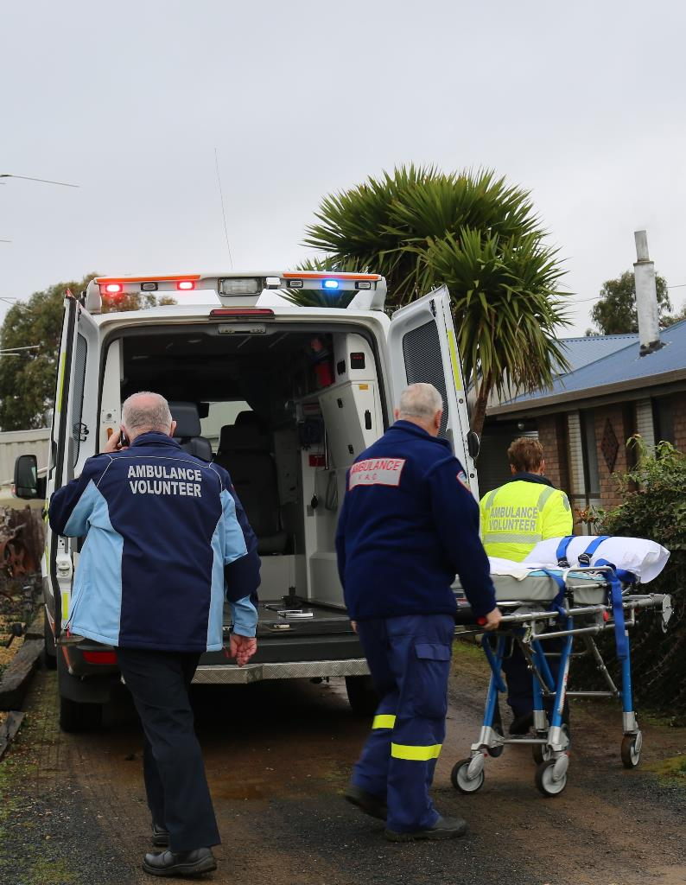
Benefits to community
Stronger, more connected communities
Improved health and wellbeing
Less crime
Charities, social services
Emergency services
Schools, sports, politics
Notes:
Part Two – Why Volunteer (General Volunteering Information)
Discussion prompts:
Volunteering is one of the forces keeping our civil society alive!
Benefits to community, include:
Stronger, more connected communities are more resilient to change, and more people want to live there
There is evidence that volunteering is closely associated with happiness and wellbeing
These points, result in reduced anti-social behaviour such as crime, so communities are safer
Many charities and social services who look after the most vulnerable people in our societies, would not be able to exist without volunteers,
Emergency services rely heavily on volunteers e.g. ambulance, fire fighters, life savers, state emergency service, storm response units
Schools, sporting clubs and political parties also rely heavily on volunteers and our communities wouldn’t function without them
Can participants think of other benefits?

Slide 13
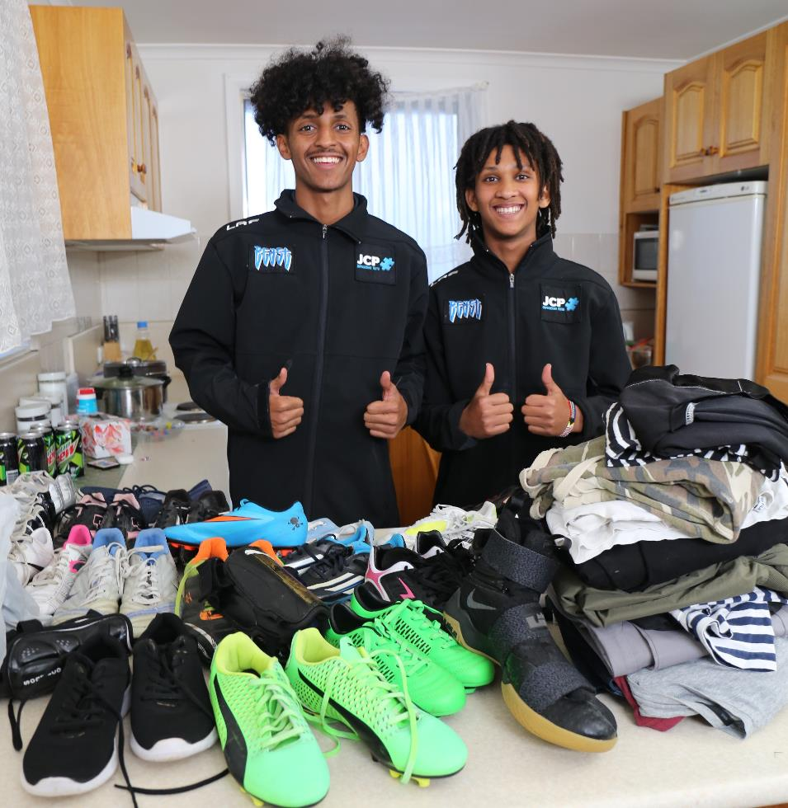
The most
important thing is…
to have fun!
an
Notes:
Part Three – When Volunteering (General Volunteering Information)
The most important thing is to have fun when volunteering!
Ideally, it should be something you enjoy doing and care about

Slide 14
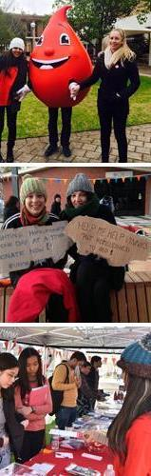
Your rights
Formal vs Informal
s Informal
Healthy, safe and supportive work environment
Clear understanding of role
Induction, training and insurance
Reimbursed expenses
Treated as part of the team
Notes:
Part Two – Why Volunteer (General Volunteering Information)
As a volunteer, you have many rights, just as an employee would.
Discussion prompts:
Rights of a volunteer include (highlight ones of relevance or interest):
To be covered by appropriate insurances;
To be asked for permission before any job-related background check / reference;
To be given meaningful tasks;
To know the purpose of the organisation;
To receive appropriate orientation and induction to the organisation;
To be trained and to have ongoing development;
To be provided with a safe place to work;
To know what the procedures are when things go wrong;
To be given feedback;
To have a supervisor or support person to talk to;
To be provided with suitable ‘tools’ for the job;
To receive reimbursement of agreed expenses;
To be given a verbal reference or statement of service;
To be respected and valued for your contribution;

Slide 15
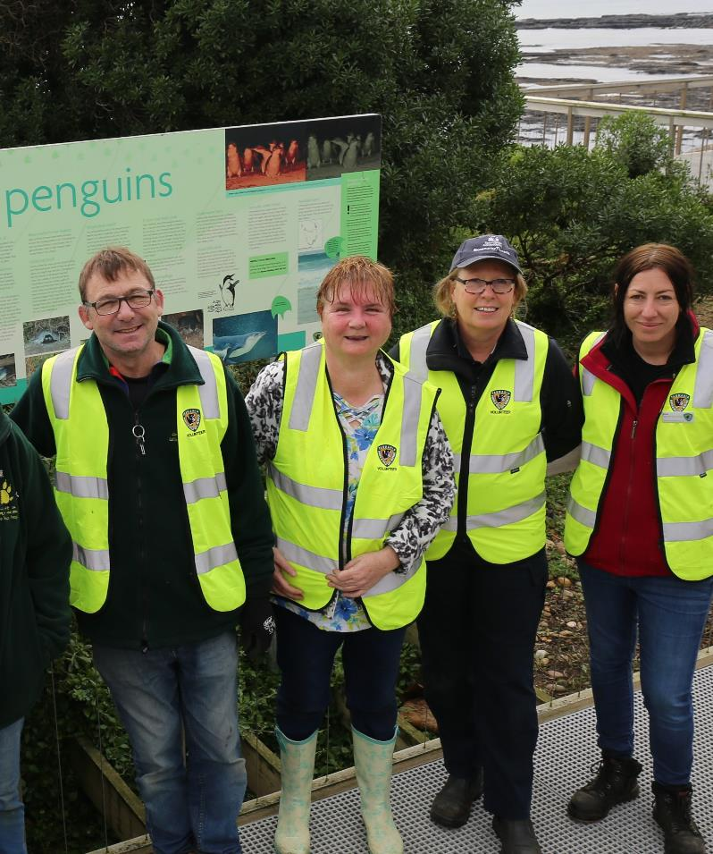
Your responsibilities
s Infor
Carry out agreed tasks
Compliance checks e.g. WWVP, police check
Be punctual and reliable
Abide by policies and procedures
Ask for help when needed
Formal vs Informal
Notes:
Part Two – Why Volunteer (General Volunteering Information)
Just like a paid employee, you also have responsibilities as a volunteer, which include turning up when you say you will and doing what you’ve agreed to do
Discussion prompts:
Compliance checks of WWVP cards and police checks may be supported by the organisation – in the application process and also the cost.
Check with the organisation you are volunteering with

Slide 16
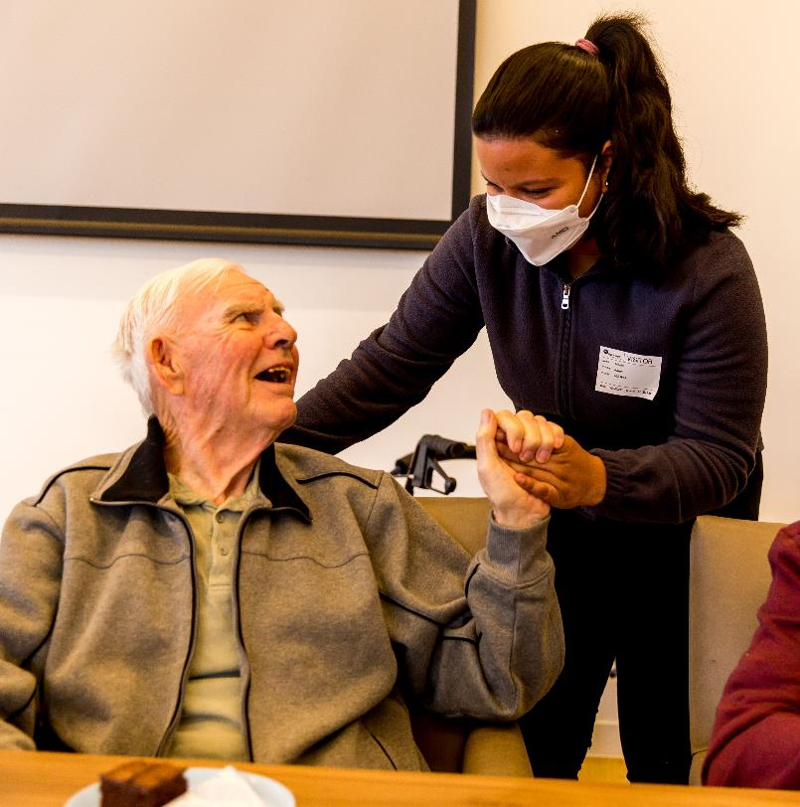
Is it unpaid work or volunteering?
Unpaid work might be work experience, internship, unpaid trial or student placement
Some unpaid work opportunities are lawful, but some are unlawful
Depends on nature, purpose and timeframe of the agreement
If unsure, seek advice from Fair Work 13 13 94 or fairwork.gov.au
Red Cross Work Right Hub resources and online training
Notes:
Part Two – Why Volunteer (General Volunteering Information)
What is the difference between volunteering and unpaid work?
Discussion prompts:
Have participants heard the other terms – work experience, internships, student placements etc? (see below for further clarification)
Sometimes people undertake unpaid work, in the hope of getting a paid work down the track with the same employer or another employer in the same/similar industry.
This might be okay, if there is a clear agreement and understanding between both parties.
Some employers intentionally exploit migrants, and some employers/organisations are simply ignorant on the matter.
Also, some migrants are unaware of the laws
Fair Work Australia’s website is useful for this:
https://www.fairwork.gov.au/tools-and-resources/fact-sheets/unpaid-work/unpaid-work-unpaid-work
Also Red Cross Work Right Hub has resources and contacts about modern slavery and exploitation at work. See: www.redcross.org.au/workrighthub Work Right Hub | Australian Red Cross
Also a free online training module Understanding and Responding to Labour Exploitation in Migrant Communities
When looking at whether an employment relationship exists, the nature of an arrangement should be considered, not just how the parties have chosen to describe it. The following factors should be considered:
What is the nature and purpose of the arrangement? Was it to provide a learning experience or was it to get the person to do work to assist with the ordinary operation of the business or organisation? Where the arrangement involves productive work rather than just meaningful learning, training and skill development, it is likely to be an employment relationship.
How long is the arrangement for? The longer the period of the arrangement, the more likely the person is an employee. Although even relatively short engagements can still be an employment relationship.
How significant is the arrangement to the business? Is the work normally performed by paid employees? Does the business or organisation need this work to be done? The more integral the work is to the function of the business, the more likely it is that an employment relationship could be found.
What are the person's obligations? In some cases a person might do some productive work to aid their learning. An employment relationship is unlikely to be found in these circumstances if:
Who benefits from the arrangement? The main benefit from a genuine unpaid work arrangement should flow to the person undertaking the role. If the business or organisation is gaining a significant benefit from the person's work, an employment relationship is more likely to exist.

Slide 17
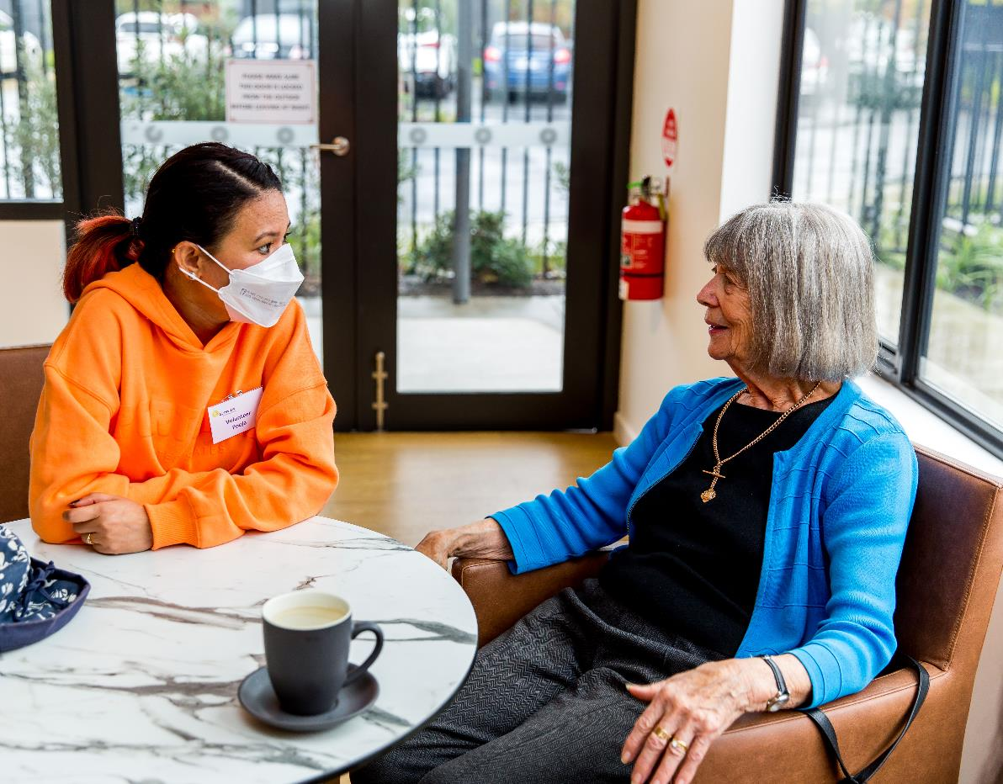
How to volunteer?
Notes:
Part Three – How to Volunteer (General Volunteering Information)
How do you go about volunteering?
Discussion prompts:
Ask the group if they know how to find a volunteer role, if they’ve tried to volunteer before, what sort of volunteering opportunities they know about

Slide 18
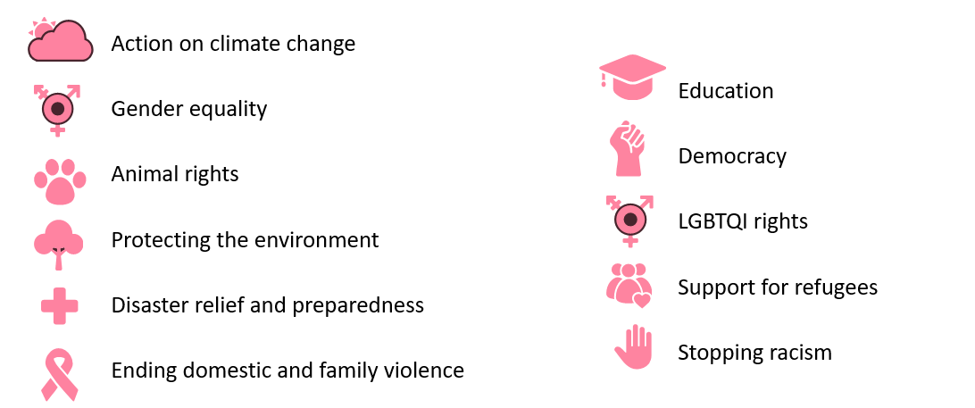
What do you care about?
Notes:
Part Three – How to Volunteer (General Volunteering Information)
Discussion prompts:
A good place to start can be to identify the motivation or reason people have for volunteering.
Why do you want to volunteer?
Do participants care deeply about a particular topic? How do they want to make a difference?
There are lots of volunteering opportunities available across many different areas.

Slide 19

Types of volunteering
On-going – a few hours per week, medium to long term
Short Term – project work with a start and end date
Special Events –usually a single day, often weekends
Episodic – during emergencies & natural disasters
Virtual and online
Notes:
Part Three – How to Volunteer (General Volunteering Information)
Discussion prompts:
There are lots of volunteering opportunities available, via many different methods and with many different time commitments
When looking for a volunteer role, think about how often you want to volunteer, how much free time do you really have for volunteering?
It might be once off to support a special event, or regularly every month or every week
Do you prefer to do in person volunteering or online or by phone?
Some organisations will require you to make a commitment of volunteering for a period of time e.g. 3 months, or 6 months. This is because of the time and resources required to train and support a volunteer.

Slide 20

Where to from here?
www.volunteeringtas.org.au
Notes:
Highlight to attendees that there are many volunteering roles online through Volunteer Connect
Available via every page on Volunteering Tasmania website
Connected to a national database of volunteering opportunities
Linked to Seek Volunteer website
Can filter to select volunteering opportunities within a certain geographic area, or by particular keywords etc
If interested, express your interest via the website but also follow up with a phone call to let the host organisation know you are keen
Many volunteer opportunities are competitive, it may help to approach it as though it were a job application
Try to make your EOI stand out e.g. write as descriptively as you can
You can also create and send a Volunteer Profile which is like a CV and can help provide more information to the host organisation

Slide 21

https://youtu.be/Pi0q74_1aGY
Notes:
Video (4:36 min) to play if there is time.
Video is in English
Ahmed and Obsa’s volunteering experience with JCP Youth and The Give Back Program
Discussion prompts:
What were the key motivations for Ahmed and Obsa to volunteer?
What do they personally gain from their volunteering?
How does their community benefit from their volunteering?

Slide 22
End of general introduction to volunteering session
NOTE: the next three sections can be adapted as applicable by volunteer organisations

Slide 23
Who we are as an organisation
(suggested content ideas only, please adapt as applicable)
What our organisation does
What values the organisation has e.g. our organisation values diversity
We know there are many great reasons why people want to volunteer
It is okay to tell us what you hope to get out of volunteering and what you need from us
How we support our volunteers
Notes:
Who Are We as an Organisation (Organisation specific section)
Add relevant info based on:
An outline of your organisation
What values the organisation has e.g. our organisation values diversity
We know there are many great reasons why people want to volunteer
It is okay to tell us what you hope to get out of volunteering and what you need from us
How we support our volunteers

Slide 24
Volunteering with us
(suggested content ideas only, please adapt as applicable)
Outline the benefits and supports the organisation offers to newly arrived migrant volunteers
How you support Cultural Safety and Inclusion for your volunteers and staff
How you respond to racism and inappropriate behaviour
We seek to be inclusive and aware that volunteers may: Speak different languages and have different beliefs and customs
Notes:
Volunteering with Us (Organisation specific section)
Add relevant info based on:
Outline the benefits and supports the organisation offers to newly arrived migrant volunteers
(Show consideration of the volunteer and their needs)
How you support Cultural Safety and Inclusion for volunteers and staff
How you respond to racism and inappropriate behaviour
We seek to be inclusive and aware that volunteers may: Speak different languages, Have different beliefs and customs

Slide 25
Becoming a volunteer with us
The types of volunteering experiences/roles available at our organisation
Range of volunteering skills needed
Time requirements - flexibility, availability, commitments
How to become a volunteer - contact information and steps involved with expected timeframes
Notes:
Becoming a Volunteer (Organisation specific section)
Add relevant info based on:
The types of volunteering experiences/roles available at our organisation
Volunteering skills needed
What sort of frequency are the volunteer roles? Do you require a minimum time commitment from volunteers? How flexible is your organisation to respond to volunteer needs?
How to become a volunteer - contact information and steps involved with expected timeframes

