Slide 1
Leading Mental Health and Wellbeing in Volunteer Workforces – The Organisational Perspective
Notes:
Time – 5 Minutes
Facilitator notes:
Tick option for audio to be played – Bree will be playing a video.

Slide 3
Program Learning Objectives
LEADERSHIP COMPETENCY DEVELOPMENT:
A character-based leadership development approach will build capacity for positive mental health, promoting self-leadership, peer leadership, and team-leadership. Training will include practical strategies to acknowledge, guide, and influence behaviour, and bring out the best in oneself and others.
MENTAL HEALTH MANAGEMENT TRAINING:
An integrated approach to workplace mental health will include knowledge and skills related to preventing volunteer-related harm to mental health, promoting positive mental wellbeing (including maximising the psychological benefits of volunteering), and appropriately addressing and supporting mental health problems as they arise.

Slide 4
Today’s Learning Objectives
By the end of today you will learn-
What the new Work, Health and Safety Regulations mean for your organisation
Practical ways to identify and control hazards that may cause physical and psychological harm
How to lead mental health in your organisation

Slide 5
Psychosocial Hazards – Know Your Part
Psychosocial hazards are anything at work that may cause psychological harm.
Notes:
Time – Slides 5, 6, 7 & 8: 30 mins
Facilitator notes:

Slide 6
Does it apply to a volunteer workforce?
The definition of ‘worker’ under the WHS Act is broad. In addition to employees, it includes anyone working for the business or undertaking, including contractors and their employees, labour-hire workers, outworkers, apprentices, trainees, work experience students and volunteers.

Slide 7
National Standards: Caring Standards
Standard 6: Workplace Safety and Wellbeing
If the organisation recruits' volunteers, it uses planned approaches to attract volunteers with relevant interests, knowledge, skills or attributes.
Potential volunteers are provided with relevant information about the organisation, the volunteer role and the recruitment and selection process.
Volunteers are selected based on interest, knowledge, skills or attributes relevant to the roles, and consistent with anti-discrimination legislation.
Screening processes are applied to volunteer roles that help maintain the safety and security of service users, employees, volunteers and the organisation.

Slide 8
Caring Standards - Questions
Do you know what WHS policies and procedures apply to your organisation? And where your responsibility sits in ensuring these are being adhered to?
Do you have these policies and procedures in place somewhere that all volunteers can also access them?
Do your volunteers know who to go to if they need to talk to someone? Do you have a plan in place in case the person they have problems with is the same as the initially listed person to talk to?
How can volunteers/stakeholders/communities give feedback? Do you have a process?
Notes:
Facilitator notes:
Walk participants through these questions

Slide 9
Updated WHS Regulations
A PCBU must ensure, so far as is reasonably practicable, workers and other persons are not exposed to risks to their psychological or physical health and safety.
A PCBU must eliminate psychosocial risks in the workplace, or if that is not reasonably practicable, minimise these risks so far as is reasonably practicable.
Notes:
Time – 2 mins
Facilitator notes:
Explain what a PCBU is: this is an umbrella term
Highlight that ‘reasonably practicable’ is key
SafeWork Australia have a guide on what ‘reasonably practicable’ means

Slide 10
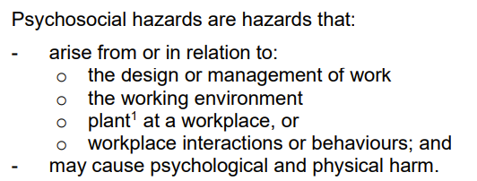
What is a psychosocial hazard?
1 WHS laws use the term plant to describe machinery, equipment, appliances, containers, implements and tools, any part of those things or anything fitted or connected to those things.
Notes:
Time – 2 mins
Facilitator notes:
Simply put, in every workplace or volunteer organization different people (with individual thoughts and behaviours) interact with each other and the work environment that they are a part of. Those interactions can lead to hazards… Does that make sense?
I will give you an example of how these hazards might look in a volunteer organization
Glenorchy Transport Museum: high job demands (during tourist season), low social support (what if one of your volunteers calls in sick?), poor supervisor support (what if due to the amount of people coming through and lack of volunteers to help you get overwhelmed?), violence and aggression (what if due to these things your patrons start to get angry?).

Slide 11
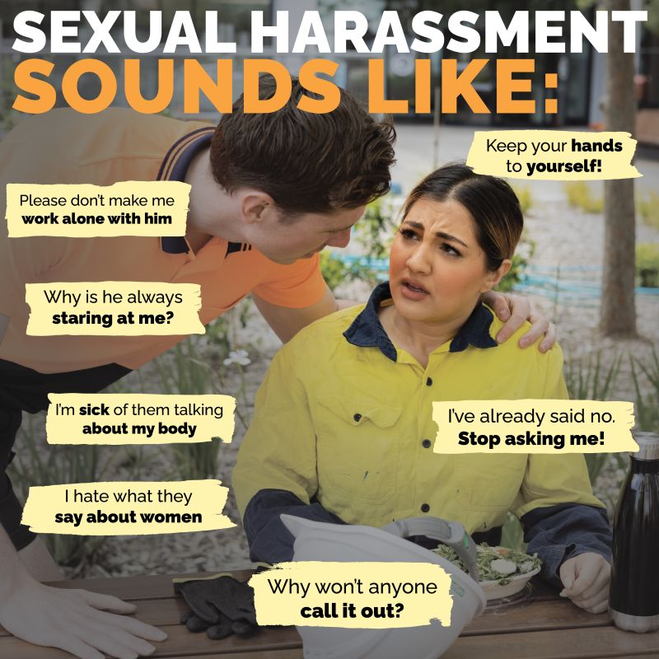
How can you identify psychosocial hazards?
Notes:
Time – 2 mins
Facilitator notes:
How can you identify psychosocial hazards? They are not as easy to see as a physical hazards, like a tripping hazard for example
SafeWork created these great posters to help explain what these hazards might sound like – Read some of the speech bubbles, you need to listen to what your volunteers are saying, are any of these things popping up? If so, there may be a hazard.
Your volunteers may use different terms to describe their exposure to psychosocial hazards (see page 19 of the code of practice)

Slide 12
Activity: Controlling psychosocial hazards
To meet the new WHS regulations you need to eliminate or minimise psychosocial hazards so far as reasonably practicable. You can do this by putting in place a control measure.
Appendix A of the Managing Psychosocial hazards at Work Code of Practice provides a list of suggested control measures that you can use to help eliminate or minimise psychosocial hazards.
In pairs, read through each of the psychosocial hazards and match them up with a control measure.
Notes:
Time: Intro: 2 mins, activity 25 minutes, 5 min debrief: Total 32 mins
Facilitator notes:
Provide each pair/group with the a pile of psychosocial hazards and control measure cards.
Debrief the results

Slide 13
Psychosocial hazards in your volunteer organisation
In pairs, discuss the following:
What hazards are present in your volunteer organisation?
What do you see, hear, feel that tells you these are hazards?
What controls can you put in place?
For 1 or 2 hazards in your organisation, identify controls you can put in place. Make your control as specific and concrete as possible.
Notes:
Time: 2 min intro, activity 25 min, 5 min debrief. Total: 32 mins
Facilitator notes:
Divide the group into pairs and have them discuss the following questions
Debrief as a group

Slide 14
Break – 11.45am
15 minutes

Slide 15
Leading your organisations approach to mental health
But first, let’s review:
What is leadership?
What is mental health?
Notes:
Time: 30 secs
Facilitator notes:

Slide 16
What is leadership really?
Leadership involves:
Relationships – the ways we connect, built trust, rapport, respect, and forge meaningful relationships
Influence – affecting how others think, feel, act (this occurs through relationships)
Collective effort – when the total becomes more than the sum of its parts
Shared purpose – when we strive together towards a common goal
Notes:
Time: 10 mins
Facilitator notes:
This slide was something that Toby Newstead covered in the first workshop and is just to remind you all that leadership isn't management, it's not position, and it's not one-size-fits-all
Leadership is about developing relationships, through which we can exert influence to bring people together to engage in collective effort towards a shared purpose...sometimes this shared purpose is grand (Gretta Thornberg, climate action), and sometimes it's somewhat mundane (getting the kids involved in cleaning the house).
Leadership does not rely on coercion, formal authority, or 'carrots and sticks'...leadership is about building genuine relationships - that recognise and bring out the best in us and others...and that protect and promote mental health and wellbeing...

Slide 17
Reviewing what leadership is
R - Recognition
I - Involvement
G – Supporting growth and development
H – Emphasising health and safety
T – Fostering teamwork
Notes:
Time: 3 mins
Facilitator notes:
A good model for mental health leadership is called R.I.G.H.T leadership and research has shown that displaying these five behaviours can help improve mental health outcomes in your organization
Recognition: refers to appreciating a person or a job well done by using various reinforcement methods such as praise or a reward.
Involvement: involving employees in organizational decisions, especially if the decisions concern them.
Growth and development: providing developmental opportunities for their employees
Health and safety: Leaders communicating the importance of health and safety both verbally (such as talking about self‐care or mental health) and non‐verbally (such as prioriting health and safety over financial gains in organizational decisions).
Teamwork: creating civility in teams, psychological safety and positivity
Any questions?

Slide 18
Reviewing what mental health is
A state of well-being in which you –
can realise your own potential
can cope with the normal stresses of life
can function effectively
can make a contribution to your community (e.g., family, friends etc.)
Notes:
Time: 2 min
Facilitator notes:
Read through the mental health definition from workshop one.

Slide 19
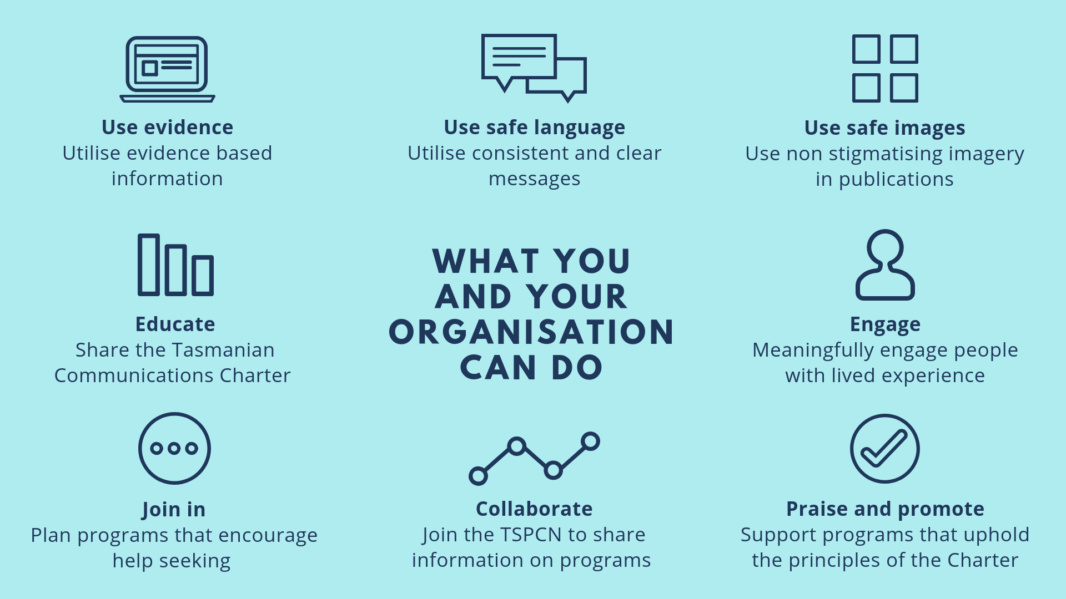
Mentally healthy workplaces Black Dog Institute – How mentally healthy is your workplace? https://youtu.be/wBEfrCtv6tw
The Tasmanian Charter
www.tascharter.org
‘The Charter’ is a tool to build an understanding of mental health and foster a supportive workplace culture.
Download and print the Tasmanian Communications Charter
Undertake the individual training to understand mental health
Take further steps to reduce stigma and build a supportive workplace
Notes:
Time: 10 minutes
Facilitator notes:
With workplaces now having a duty to protect the psychological health of workers in the same way they protect their physical safety – creating a mentally healthy workplace is a step in the right direction. However, one of the barriers to achieving this is stigma.
The following video from the Black Dog Institute provides a quick overview of how common mental ill-health is and how workplaces can support the reduction of stigma.
https://youtu.be/wBEfrCtv6tw
From the video, we can see that the experience of mental ill-health is common, and not recognising its prevalence can contribute to people not accessing supports when they need it. However, by building an understanding of mental health within the workplace - people feel less alone in their experiences, stigma is reduced, and people can feel comfortable in seeking the support that they need.
Creating an understanding and supportive workplace is key here, and the Tasmanian Communications Charter is one tool that can be used to support this.
(The Charter) as its often referred to, is a key action in the Tasmanian Suicide Prevention Strategy and aims to build a contemporary understanding of mental health with the aim of reducing stigma and fostering a supportive workplace culture through practical actions.
www.tascharter.org
One of the first actions is to get to understand the Charter itself, this can be downloaded and printed and then there is also individual training that anyone can access for free:
Individual training – at MHCT all staff take this training so that we all have a shared understanding of mental health and to gain a better understanding of how to communicate in a way that doesn’t contribute to stigma, and rather promotes a culture of help-offering and help-seeking when it comes to those around us who are impacted by mental health challenges.
For organisations and workplaces, there is also the opportunity partake in further actions which introduces the concepts of mental health and wellbeing to the workplace:
Organisational implementation –The Tasmanian Communications Charter identifies 6 key principles that can be an initial step in shifting workplace culture around mental health and wellbeing.
Use evidence
When talking about mental health use evidence based information (Black Dog Institute, Beyond Blue resources).
Use safe language
You can download language guides in the ‘for individuals’ section of the Tascharter.org website to help ensure that you’re talking about mental health in a non-stigmatising way (things like ‘psycho’,’deranged’,’mental institution’ can be common terms but can reinforce stigma around a person experiencing a mental illness and the impact that it is having on their life.
Use safe images
You will find a link to a guide on this in the same section on the website – not so specific to workplaces, but is good to know if putting together policies and including images.
Educate
One of the most useful and quickest things to do is to undertake the training online and ask those you work with to do the same. If there is no internet, download and print the charter.
Engage
Offer opportunities for people with lived experience to apply for a seat on committees and boards or join the volunteering team – diversity of skills and ideas.
Join in
You can print out help-seeking posters and information to share or join in on local events such as MHW events in your area. 7-15 October 2022, June/July grants opportunities.
Collaborate
The TSPCN, MWB Literacy project, other local networks (CORES, RAW are community based services that you could connect with and share their resources within your workplace, have them come and speak, etc).
Praise and Promote
You can also support other organisations that uphold the principles of the Charter (see a list on the website)

Slide 20
Resource kit
Start of April VT will reach out again to organise a gifting of a certificate of recognition and Resource Kit for organisations.
Would you be interested?
We’d love to tell the story of someone's journey through the workshops and reflections they’ve had, please consider if you’d be okay to answer some questions and have some photos taken.
Notes:
Time – Slides 20, 21 & 22: 35 mins
Facilitator notes:
Sarah

Slide 21
Debrief and your challenge
Make one change in your volunteer organisation to help eliminate or minimise psychosocial hazards
This could be as simple as putting up some posters to start a conversation or reviewing the Code of Practice with your team to identify some actions that you can take
Hint/Prompt: has your organisation adopted the Tasmanian communications charter?
Notes:
Time:
Facilitator notes:
This could be used to inform the case study...
NB: can Sarah follow up with the participants 2 weeks later to ask if/how participants have made their one change.
Conversation guide can be provided by UTAS team.
3-5 easy options for them to commit to taking... Put up posters...1 conversation...something

Slide 22
Wrap up
Thank you for being involved in this project!
Do you have any final comments?
Action: please complete the feedback survey
Notes:
Time:
Facilitator notes:

