Slide 1
Supporting the Mental Health of Volunteer Workforces: Looking at Others

Slide 3
Program Learning Objectives
LEADERSHIP COMPETENCY DEVELOPMENT:
A character-based leadership development approach will build capacity for positive mental health, promoting self-leadership, peer leadership, and team-leadership. Training will include practical strategies to acknowledge, guide, and influence behaviour, and bring out the best in oneself and others.
MENTAL HEALTH MANAGEMENT TRAINING:
An integrated approach to workplace mental health will include knowledge and skills related to preventing volunteer-related harm to mental health, promoting positive mental wellbeing (including maximising the psychological benefits of volunteering), and appropriately addressing and supporting mental health problems as they arise.

Slide 4
Today’s Learning Objectives
By the end of today you will learn -
How to provide virtues-based feedback and recognition (replacement behaviour)
Understanding others’ mental health and wellbeing
Skills for discussing mental health and wellbeing issues with others

Slide 5
Ground Rules & Virtue’s Pick
In this session we will demonstrate –
Trust
Respect
Courage
Empathy
Duty of care
Learning program not therapy
Notes:
Slides 1-5: Time – 5 mins
Facilitator notes:
Tick option for audio to be played
Select option for breakout rooms
Send resources (offering companioning, list of virtues, how to speak the language of virtues and language guides) and jamboard link to participants, confirm that they are open

Slide 6
A virtues-based, character-first approach to leadership
Anyone can lead
Good character is the foundation of good leadership
Character is composed of virtues
Notes:
TIME: 15 minutes for slides 6-10
Facilitator notes:
Anyone can lead – and everyone DOES lead
The foundation to good leadership is good character
Character is composed of virtues...virtues are inherently good character attributes
We all have all the virtues, in varying states of development
We all have some virtues that we are quite strong in, that are well habituated...and some we have room to grow, that we are still practicing.
By practicing virtues, we develop good character, and enhance our ability to engage in the relational processes of leadership.

Slide 7
What are virtues?
Virtues are inherently good character attributes
We all have all the virtues, in varying states of development
We all have strength and growth virtues
Practicing virtues develops good character, which supports good leadership
Notes:
Facilitator notes:
Virtues are inherently good character attributes
We all have all the virtues, in varying states of development
We all have some virtues that we are quite strong in, that are well habituated...and some we have room to grow, that we are still practicing.
By practicing virtues, we develop good character, and enhance our ability to engage in the relational processes of leadership.

Slide 8
What are your strength (and growth) virtues?
Fortitude
Bravery
Daring
Valour
Persistence
Integrity
Perseverance
Zest
Industriousness
Vigour
Authenticity
Honesty
Vitality
Enthusiasm
Energy
Resilience
Love
Kindness
Care
Generosity
Nurturance
Compassion
Niceness
Empathy
Helpfulness
Citizenship
Social-responsibility
Loyalty
Accountability
Fairness
Teamwork
Leadership
Autonomy
Dignity
Respect
Practical-wisdom
Insight
Decisiveness
Understanding
Detachment
Judgement
Moderation
Patience
Forgiveness
Mercy
Humility
Modesty
Prudence
Self-control
Self-regulation
Honesty
Appreciation-of-beauty
Excellence
Awe
Hope
Gratitude
Optimism
Future-mindedness
Humour
Playfulness
Spirituality
Purpose
Faith
Meaningfulness
Creativity
Originality
Ingenuity
Curiosity
Interest
Novelty-seeking
Openness
Critical-thinking
Love-of-learning
Perspective
Notes:
Facilitator notes:
Invite ppl to make note – can us the chat
1-2 min quite to read and reflect
Opportunity to share any observations, reflections, insights...

Slide 9
Today we’ll focus on 2 virtues-based leadership strategies
Listening
Giving effective feedback

Slide 10
Strategy 1: Listening deeply
Notes:
Facilitator notes:
@Kate – if you could past the following into the chat, please:
Open the door, “what is happening” or “what are you thinking/feeling?”
Offer receptive silence
Ask clarifying or cup-emptying questions, “what was that like?”
Get to the heart of the matter, “what was hardest/worst/best/scariest/happiest/most exciting?”
Re-fill the cup, “what would help you to ... “
Give recognition, “I can hear your... Courage – determination – openness – optimism – wisdom (or other appropriate virtue)”.

Slide 11
Practice listening deeply. In breakout rooms, apply the companioning process as you and your partner share your response to the following prompt:
Reflecting on your own volunteering experience, what consequences (good or bad) can a leaders communication have
Notes:
TIME: 10 minutes, 5 minutes to share observations/feedback
Facilitator notes:
@Kate – if you could past the following into the chat, please:
Open the door, “what is happening” or “what are you thinking/feeling?”
Offer receptive silence
Ask clarifying or cup-emptying questions, “what was that like?”
Get to the heart of the matter, “what was hardest/worst/best/scariest/happiest/most exciting?”
Re-fill the cup, “what would help you to ... “
Give recognition, “I can hear your... Courage – determination – openness – optimism – wisdom (or other appropriate virtue)”.
Share observations & feedback

Slide 12
Strategy 2: Giving effective feedback
Notes:
TIME: 10 minutes for slides 13-14
Facilitator notes:
The second virtues-based leadership strategy we’ll focus on is how to use virtues to give more effective feedback.
Virtues-based recognition is all about recognising and focusing on the person – their character – the virtues they’ve demonstrated...rather than the task they’ve done or the mistake they’ve made...

Slide 13
Reflect on your volunteering context: What is one piece of feedback you often give (or receive)? Or What is one piece of feedback you feel awkward giving (or receiving)? Or What is one piece of feedback that you wish you gave (or received) more often...? Write it down.

Slide 14
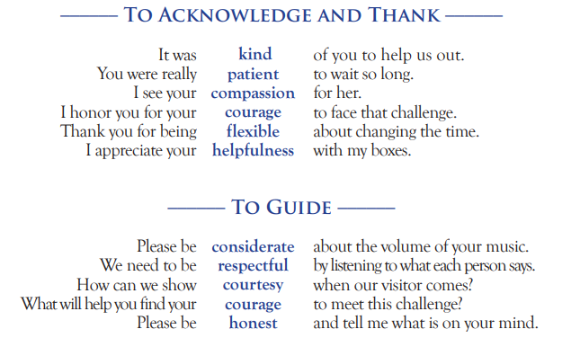
Strategy 2: Giving effective feedback
Using virtues to acknowledge and guide desired behaviour.
Notes:
Facilitator notes:
Recognising and focusing on the person – their character – the virtues they’ve demonstrated...rather than the task they’ve done or the mistake they’ve made...

Slide 15
Practice re-phrasing feedback as virtues-based feedback.
In breakout rooms, work together to figure out how to rephrase the feedback as virtues-based feedback.
Refer to the handouts emailed around earlier, including the speaking the language
And virtues list
Notes:
TIME: 15 minutes, 5 minutes for observations/feedback
Facilitator notes:
Breakout rooms
Sharing & feedback

Slide 16
Break – 11.05am
10 minutes
Notes:
Time: 10 minutes​

Slide 17
Communicating with others about mental health
Promote connection and help seeking
Social support is a critical survival need
We all need to be heard, and feel seen/important to others around us
You might change someone’s journey through life with a conversation
Notes:
Slides 17-18: Time – 5 mins
Good morning, everyone, the session today is about “communicating with others about mental health”. Learning how to communicate with people in your volunteer organisation, or life in general really, will help you to
Promote connection and help seeking
As human beings we all need good relationships. The research tells us that a big part of volunteering, especially for the older demographic, is that we can connect with each other and sometimes fill that void that can be lost when we stop working. A good relationship though is one where we can trust each other, and that we feel that we belong or are included. Learning to communicate well with each other, especially on what can be considered a sensitive topic, like mental health, will help us to build this trust with each other.
Social support is a critical survival need
It’s not just a nice to have. Many studies show that social support is essential for maintaining good physical and psychological health but to receive those benefits
We all need to be heard, and feel seen/important to the others around us
People need to feel that they can be authentic and that they can show up authentically. If you provide space for people to do this
You might change someone’s life through just a conversation
Communicating about mental health shouldn’t be about trying to be a psychologist, it’s about listening genuinely and without judgement and helping someone to seek help when and if it is needed.
With the person next to you, it would be great if you can discuss
A time when you have tried to help someone who has a mental health issue and how that experience was for you.
(What did you feel comfortable with during that conversation and what did you not feel comfortable with?)
Let’s take 5 minutes to chat about that and then we can come back together as a group to share our experiences
Do anyone have an experience where they have tried to provide mental health support in their volunteer organisation?
I also want to highlight that for some of us we are raised to believe that to ask someone about their mental health is rude or that it’s none of our business. But let’s consider for a moment if someone was to be wearing a cast on their leg or on crutches or if they had some physical health issue. It’s almost a natural impulse for a lot of us to offer that person help. I think also that we fear what will happen if we start a conversation about someone’s mental health. Some folks worry that they will become responsible for that person or that they need to ‘fix’ the person when really it is just about providing space for someone, being there to listen non-judgementally. We don’t have to be counsellors or psychologists and we certainly shouldn’t try to do that, we just need to show up.

Slide 18
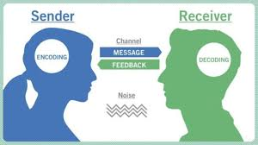
Communication skills
Notes:
Facilitator notes:
This slide is about the most basic form of communication that we all engage in every day. This isn’t just about just communicating about mental health, it’s communication in general. We can simply call it the sender-receiver model. For this type of communication, we have a person who is shares a message, or is the sender of a message, and a person who receives that message. We can share these messages through many different channels, in person, via email, over zoom and that can influence how the message is received. What can happen during that interaction though is that there can be a lot of ‘noise’ that sidetracks the receiver from getting the message clearly. I’m not talking about physical noise here, but the mental noise that sometimes distracts us. Some examples of noise could be that a person is thinking about a stressful conversation that had with a family member that morning or may maybe their house was flooded and they are dealing with the insurance company. That noise can make it difficult for them to receive the correct message from the sender.
In the context of talking about mental health there can be a lot of noise that makes it difficult for the person to receive the correct message so it’s important to go into these conversations knowing that. We will now talk through some of the ways that you can help to reduce or remove this noise.
Does anyone have an example of where they have been talking to someone and they have taken your message in the wrong way?

Slide 19
Mental Health Council of Tasmania:
Talking about mental health
Why it’s important to check in on colleagues, family and friends
How stigma plays a role in having conversations about mental health
Making conversations easier
​
​
Notes:
Talking about Mental Health (10 – 15 mins total)
Intro – connect back to slide 15 and 16
We can all find it awkward to have conversations about mental health, but as discussed, it might change a life and it might just be what someone needs.
This workshop, I’ll share with you a video from Beyond Blue which really reiterates why its important to check in on those around us.
We’ll then look at how stigma plays a role in making it awkward/uncomfortable to have these conversations.
And lastly we’ll consider how we can make these conversations easier to have.
Why its important to check in on collegues, family and friends:
“Beyond Blue video” https://www.beyondblue.org.au/mental-health/supporting-someone
Beyond Blues’ information on why its so important to talk about mental health. But how do we do it in a way that’s inclusive and supportive. And helps people to feel safe to share what is happening for them? How do we do it in a way that’s not awkward or difficult? Often our own stigma can get in the way.
If someone turned up to work with a cold, we’d ask if they’re ok and send them home with a few remedies and maybe tell them to go the GP if they aren’t getting any better after a few days. If we recognized someone at work was withdrawn and not like themselves, would we do the same? Do we share when we’re not doing so well emotionally? Feeling overwhelmed, or sharing stories about how we might be struggling? Do we experience our own stigma and not want to share it with others?
How stigma plays a role in having conversations about mental health
*Stigma video* https://www.tn.gov/behavioral-health/stigma.html
Break out groups 3 mins
How has history influenced the way we think about mental illness today?
What kind of words might you use instead of the ones listed on your sheet? (provide sheet to Sarah)
What analogies can you draw between mental health and physical health?
Combine in Ange’s jamboard questions here
- Why is mental health considered difficult to talk about?
- What concerns do you have about supporting other people’s mental health through check in conversations?
Main group 5 mins
Response to questions 1 and 2
Response to question 3
Making conversations easier
The more we change our understanding of mental health, the more we will feel comfortable to have conversations with others about mental health. The more we normalize and share our own stories either from our own personal experience or our experiences of caring for loved ones, the more we make it easier for others to do the same, and to open up when their not doing so well.
Feeling comfortable about talking about mental health. It starts with having more general and open conversations about mental health. Talking about it, just as we would our physical health. Building up a language and dialogue with family, friends and colleagues so that when we recogise that someone isn’t doing well, you can have that conversation a little more confidently.
What to do
Start to drop a few mental health/physical health analogies into your conversations
Do the Tasmanian Communications Charter training to get some more understanding about talking about mental health
Use the language guide to help when you are having a conversation about mental health

Slide 20
Reducing mental illness stigma
Everyone can help reduce stigma about mental illness. Some simple ways that you can do this are:
Actively dispelling myths and educating people against harmful, inaccurate stereotyping when negative stereotypes come up in conversation or in the media.
Being mindful about the words you use when describing yourself or others, avoiding insensitive and hurtful words, and words which define a person by their condition.
Speaking up when you hear people make inappropriate comments about mental illness..
Notes:
Slides 20-26: Time – 45 mins
Facilitator notes:
Read the below points before reading through this slide –
In relation to mental illness, stigma is when someone is marked or discredited somehow, or reduced from being a whole person to being a stereotype or labelled as a collection of symptoms or a diagnosis (e.g. ‘psychotic’).
The meaning of the word stigma is a mark, a stain or a blemish.
People with mental illness may face stigma — they may be viewed in a negative way, treated differently, and made to feel ashamed or worthless, as if they are somehow less than other people. Stigma can also lead to discrimination, and this in turn can make mental illness worse.
As you saw in the ‘negativity, fear and stigma’ video, stigma can be very harmful to those with a mental illness

Slide 21
Having mental health conversations in a work context
Head4Work
Notes:
Facilitator notes:
Have Head4Work videos ready to play – Ange.
Play two videos from Head4Work – “More common than you think” & “Negativity, fear and stigma”
N.B. this will require a Head4Work login

Slide 22
https://vimeo.com/283591379
How to ask R U OK?
Notes:
Facilitator notes:
ALEC – ask, listen, encourage, check in
What did we think about that video?
R U OK? Is one of the most recognised mental health campaigns in Australia and it’s gives us a really simple strategy to help us have better conversations about mental health

Slide 23
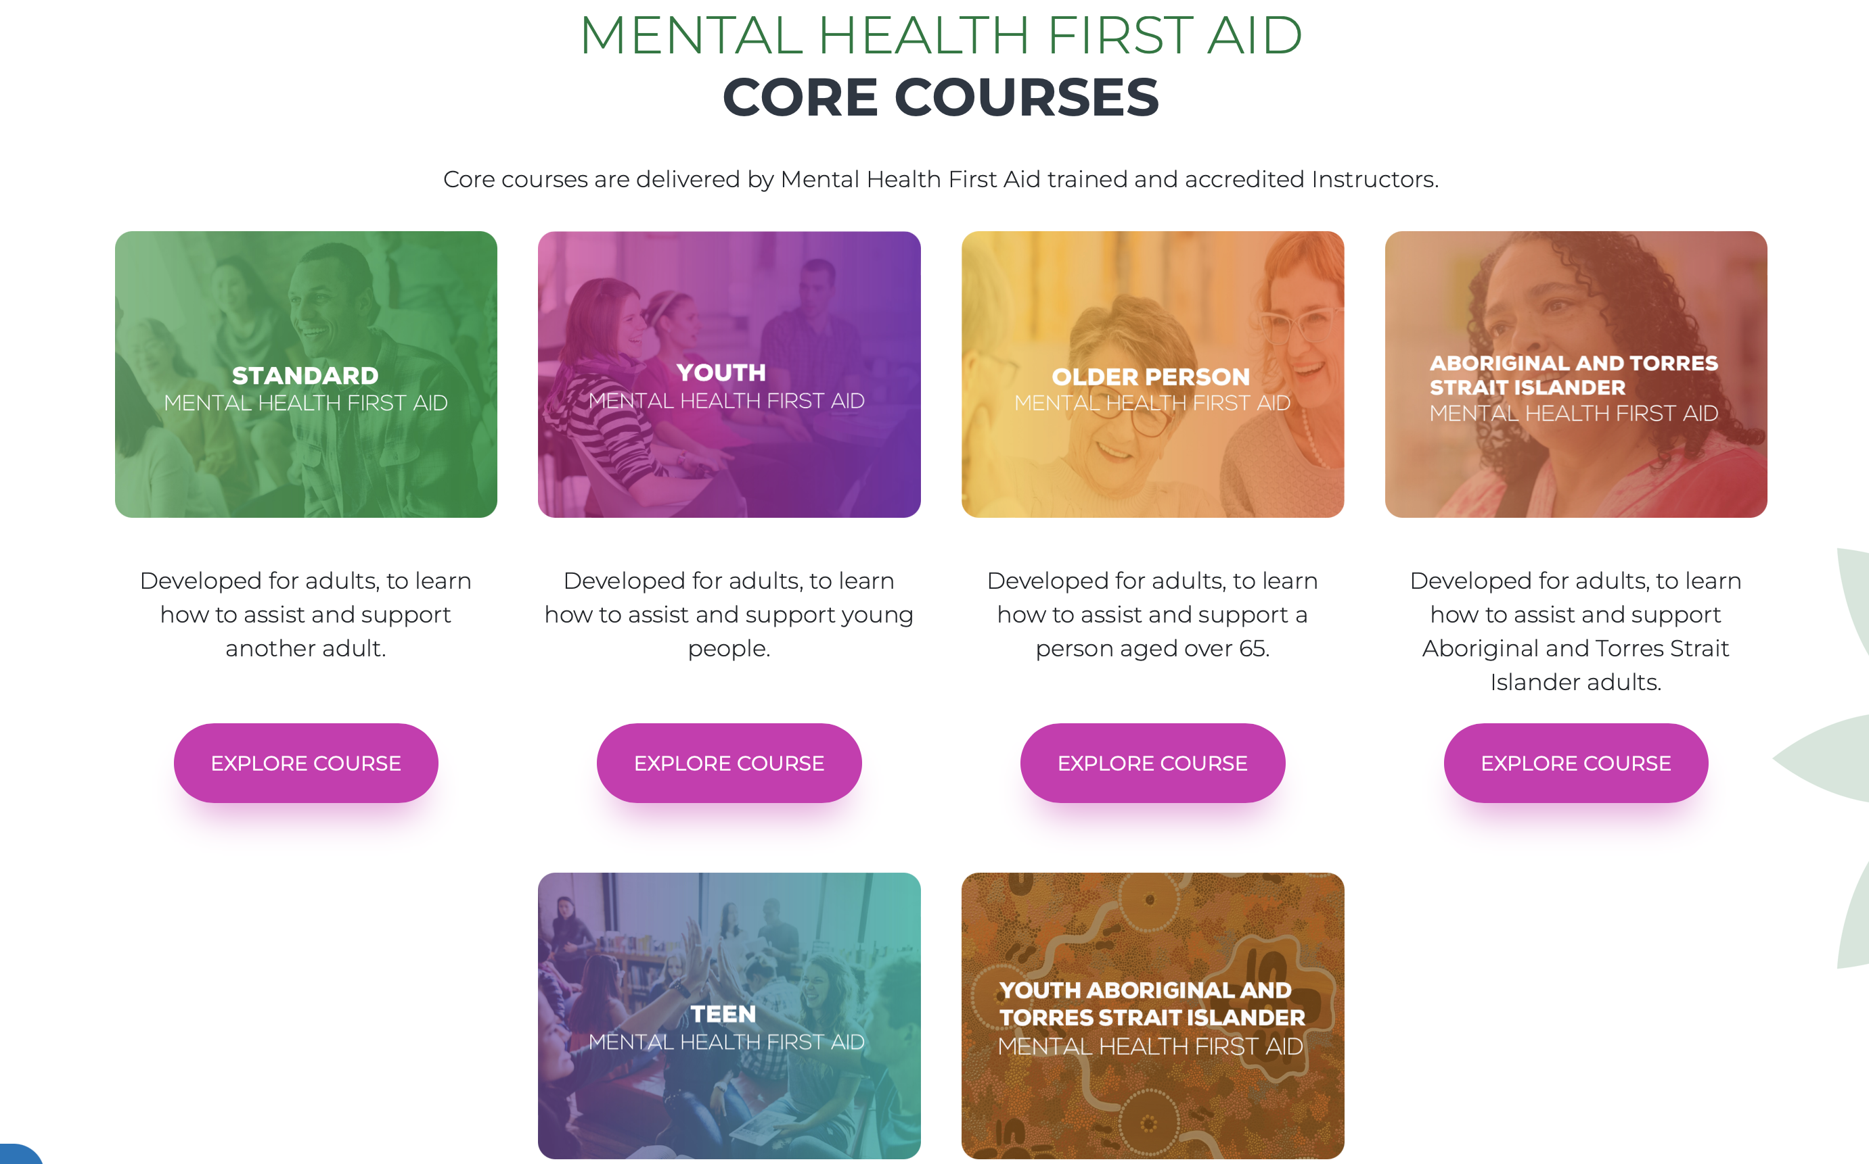
Notes:
Facilitator notes:
Just a raise of hands. Who here has done mental health first aid?
As you can see on the screen, there are lots of different MHFA courses.
MHFA is popular and one way that we can do to help improve our awareness of different types of mental illness and some of the signs and symptoms that we can look out for.
What is important to note though is that MHFA focuses on mental illness and in some cases quite severe and less common mental illness, such as eating disorders and psychosis. Although it is great to be equipped with this knowledge it’s important to remember that not everyone who struggles has a mental illness. As Ange would have said in the first workshop, we all have mental health and that will change throughout the course of our lives so we want to make sure we are prepared to have a conversation with everyone, not just those who have a mental illness.

Slide 24
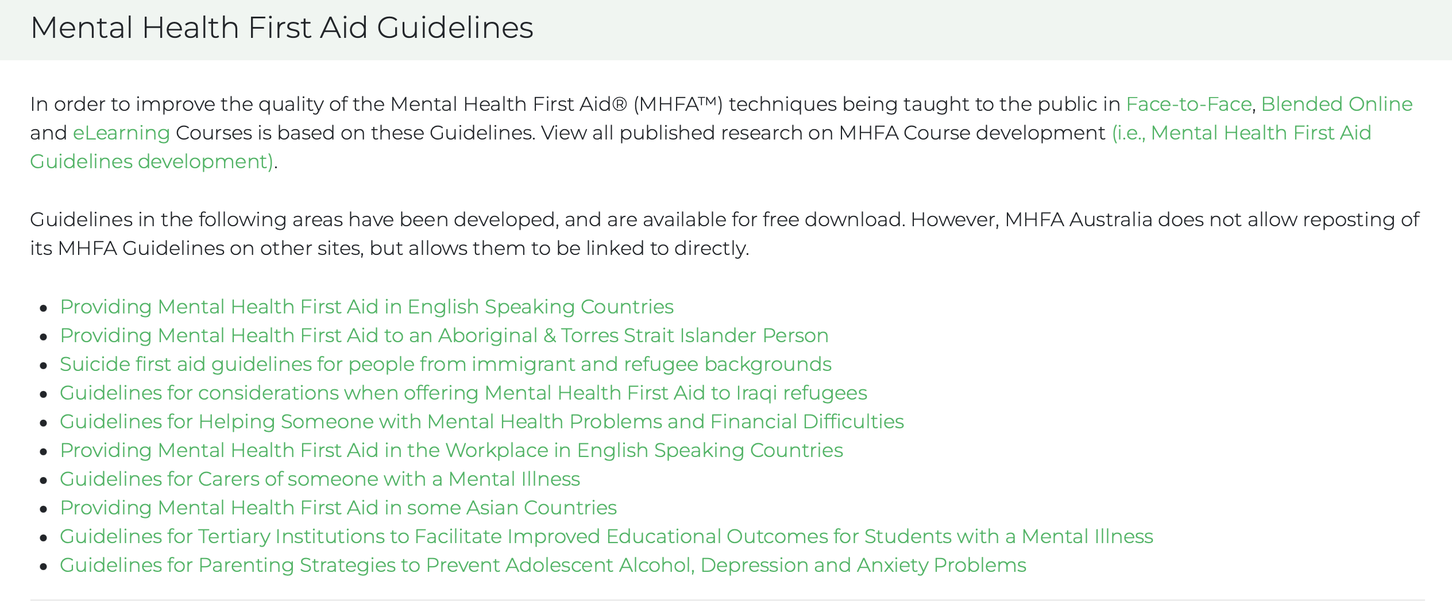
Notes:
Facilitator notes:
MHFA has developed some great guidance materials to help you have discussions with people from different walks of life. Some of the resources include, providing MHFA for Aboriginal or Torres Strait Islander peoples, people from immigrant or refugee backgrounds, people from Asian countries etc.
You will come across people from all different backgrounds in volunteering.
In some Asian countries for example to talk about your mental health can cause a lot of shame or be seen as a weakness or reflect poorly on your family. Other cultures many see a mental illness as a spiritual or demonic possession. The point to remember is that not everyone will see mental health in the same we do in the west so it’s good to understand these differences to help prepare you for these conversations and to ensure the messages that we send are received in the right way.

Slide 25
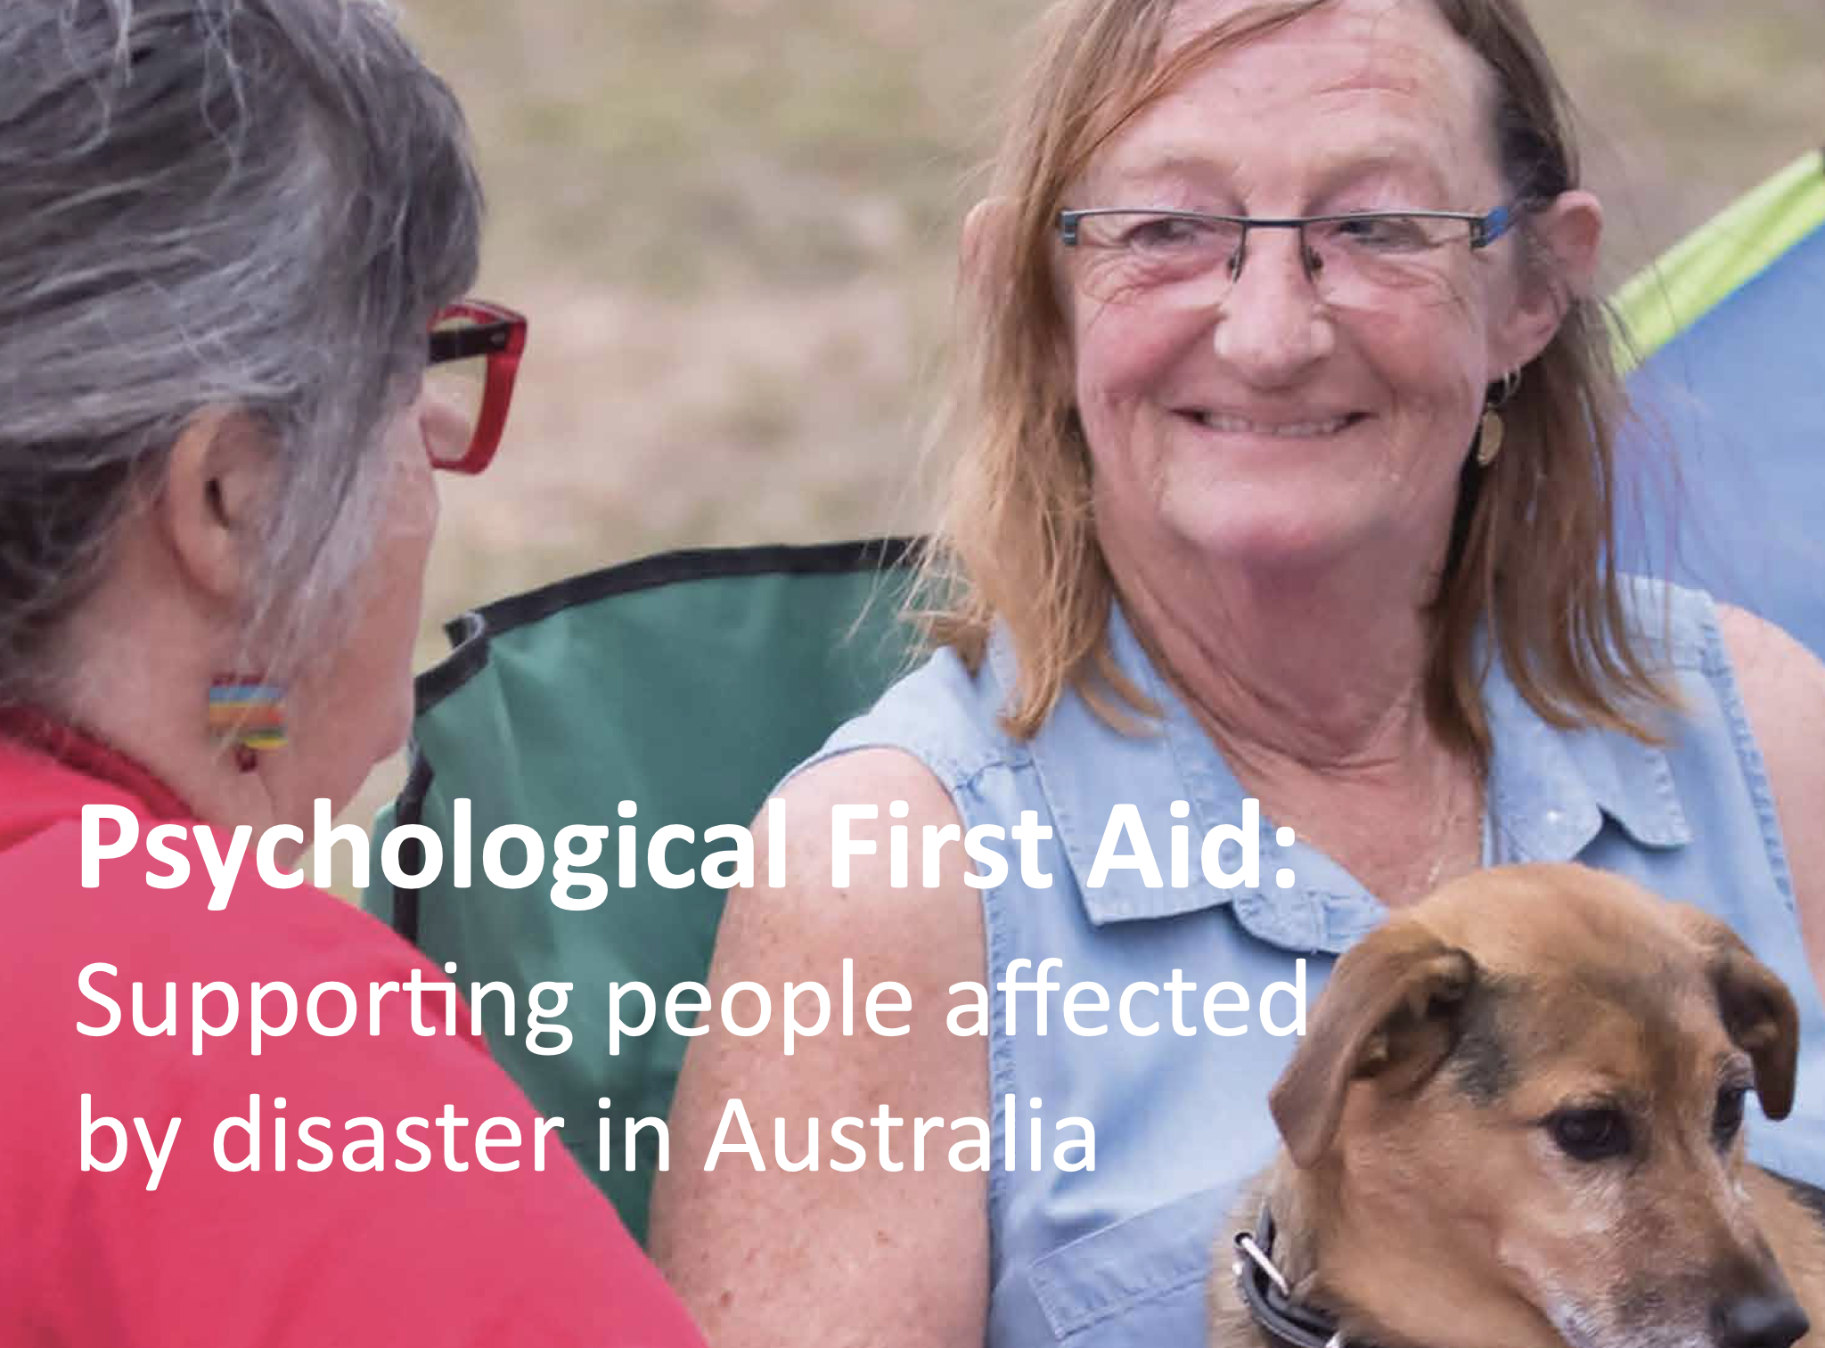
Notes:
Facilitator notes:
Psychological first aid has been around since 2002 and this guide here was developed by the Australian Red Cross. Sarah has printed out some packs for anyone who wants to learn more about this.
Helping people affected by an emergency, disaster or traumatic event. For example, the recent weather events that we have had in Tassie and the impact this would have had to some people. Psychological first aid involves helping people to feel safe, connected to others, calm and hopeful, and ensuring access to physical, emotional and social support. It is a ‘humane supportive response to a fellow human being who is suffering and who may need support’
We will all experience a range of different reactions after a disaster (physical, psychological, emotional and behavioural) that will impact their ability to cope. These reactions are normal and understandable given the person’s experience.
During these events, there will be a small part of the affected population will have more complex reactions and will require further mental health support. But most people recover well on their own with the support of compassionate and caring disaster workers, family and friends.
The language shifts here, it’s not about providing mental health support, we instead call it psychosocial support. What psychological and social needs do people have in those moments? What are the immediate emotional and practical needs of a person who has experienced a disaster?
It is not useful to directly encourage someone to talk about what just happened if they don’t want to. We shouldn’t push people. Post-emergency settings are not clinical environments so we shouldn’t be trying to conduct clinical conversations
Help people to build their capacity to recover. An important research finding is that a person’s belief in their ability to cope can predict their outcome. People who tend to have better outcomes are optimistic, positive and hopeful.
Psychological first aid is about making people feel safe and secure, identifying and assisting people with their current needs, establishing human connections, helping people to identify their own strengths and abilities to cope. It’s that simple!

Slide 26
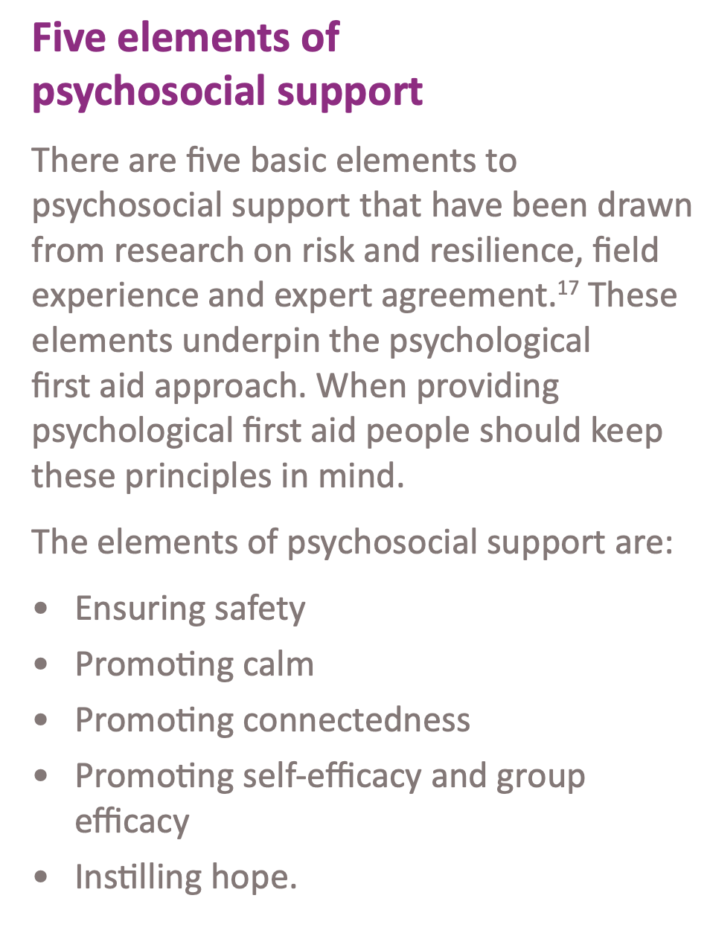
Notes:
Facilitator notes:
Ensuring safety
If people feel under threat or they don’t feel safe they will continue to experience negative reactions
Some ways that we can help people feel safe is
Remove them from harm
Helping them to meet their basic needs. Do they have food? Do they have water? Do they have shelter?
Helping people to obtain medical attention if they need it
Providing physical and emotional comfort
Providing simple and accurate information on how to meet their basic needs. As we said earlier about communication, there would be a lot of noise after a disaster so we need to help people receive the right message
Promoting calm
Stress is normal after a disaster but ongoing stress can lead to the development of mental illness so it is important to help normalise stress reactions
Some ways to do this is
Providing an environment, as far as practical, that is removed from stressful situations or exposure to the sights, sounds and smells of an emergency
Listening to people who wish to share their stories and emotions but not forcing them to talk
Remembering that there is no right way to feel
Being friendly and compassionate even during difficult interactions with people
Providing information on stress or coping
Offering accurate information about the relief efforts that may be underway
Promoting connectedness
Having access to social support following a crisis increases opportunities for emotional understanding, knowledge to be shared, to normalise reactions and solve problems. Good social support is related to better emotional wellbeing and recovery
Some ways to do this are
Helping people contact their friends or loved ones
Keeping families together
Helping to establish contacts with support people
Providing information and directing people to the services that are available
Respecting cultural norms regarding gender, age, family structure and religion
Promoting self efficacy (produce the desired result)
We talked about this before, if people have a sense of control over positive outcomes in life they are generally better off from a psychological point of view. Before a disaster the person probably had that sense of control but it can be lost in times of crisis and we just want to remind people that they still have that efficacy
Some ways to help improve this are
Engaging people to meet their own needs
Assisting them with decision making and helping them to prioritise their problems and solve them
Instilling hope
Those who remain optimistic have better outcomes following a crisis.
Some ways to help improve this are
Creating an expectancy that things will get better
Being there and being willing to help
Reassuring people that their feelings are normal
That’s it from me! Any questions?

Slide 27
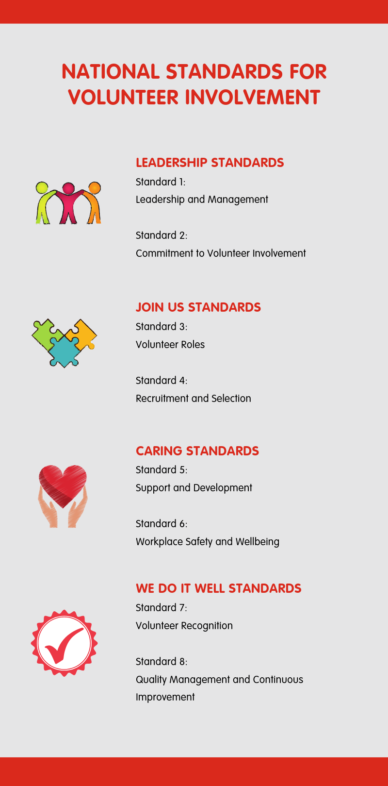
https://www.volunteeringaustralia.org/resources/national-standards-and-supporting-material/#/
Notes:
Time: 10 minutes for slides 27-30
Facilitator notes:
How many volunteers do you represent? - comment in the chat box

Slide 28
Standard 7: Volunteer Recognition
Volunteer contribution, value and impact is understood, appreciated and acknowledged.
How do you volunteers want to be recognised?
How do you show appreciation for your volunteers?
Do you have a budget allocated to thank and celebrate volunteers? E.g. to oragnise a thank you BBQ or other activity?
What can you do for National Volunteer Week (May) and International Volunteer Day (December)?
Do you acknowledge birthdays and milestones?
Are volunteers mentioned in your Annual Report and marketing?

Slide 29
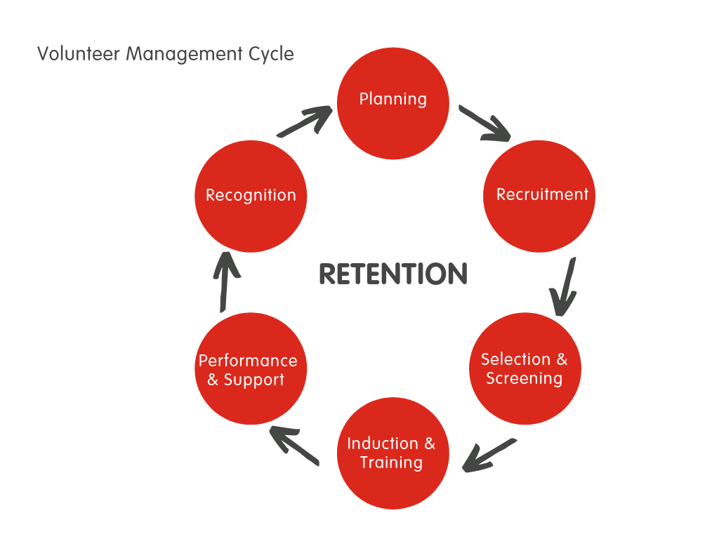
Planning and recruiting for the future
When recruiting and filling roles, it is important to be planning for the future at the planning stage.
Looking at the best practice volunteer management cycle:
At what stage do you plan for when the volunteer relationship ends?
What processes do you have in place where volunteers can provide feedback in the role they fill? Can they suggest/make changes? What does change look like?
Do you prepare existing volunteers to step up into existing roles​?
Do you ask existing volunteers interest to step up before promoting for new volunteers?
Do you invite volunteers who show interest to gain experience in other roles?
When do you need to end a volunteer relationship?
How will you do this?
What supports do you have in place for the organisation and volunteers during this?
Do you have processes in place to conduct exit interviews, and to understand and respond to reasons volunteers may choose to leave?

Slide 30
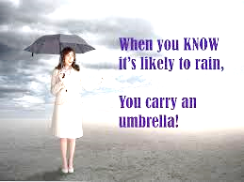
Succession Planning
What does your succession plan look like?
Do volunteers feel they can leave when they are ready to?
Are volunteers able to take long periods of leave, and are supported to do so?
How often do you hear “we need younger volunteers?”
It is recommended best practice to have the following in place:
Have a volunteer continuity plan
Implement an assistant/buddy system
Ensure roles do not become people dependent
Have position descriptions​ for all volunteer roles
For roles that require it, have a manual or process guide
What does handover look like?
Do you action volunteer feedback?
When there isn’t a succession plan in place, we often find:
Volunteers can feel they cannot leave, and must stay
Volunteers do not take periods of leave at risk of letting the organisation down
Sometimes they may feel irreplaceable
They may form a feeling of ownership/connection to the role/organisation
There may be poor record keeping in relation to the role
There is likely to be conflict or someone who ends up unhappy and feeling unvalued

Slide 31
Wrap up
One strategy from today that you’ll implement with someone in your volunteer context (or anyone)
Look for an opportunity to support someone: offer companioning/listening, virtues-based feedback, offering support – referral (only do this if you feel comfortable)
Volunteering Tasmania will check in with you all after the workshop to see how you went with the above activities (we will discuss this further at the next workshop)
Notes:
Time – 5 mins
Facilitator notes:
Re-open breakout rooms and have participants discuss a strategy
For point two, provide a disclaimer to ensure that the participants feel comfortable to support someone and that they have a chance to debrief afterwards

